Slide 1
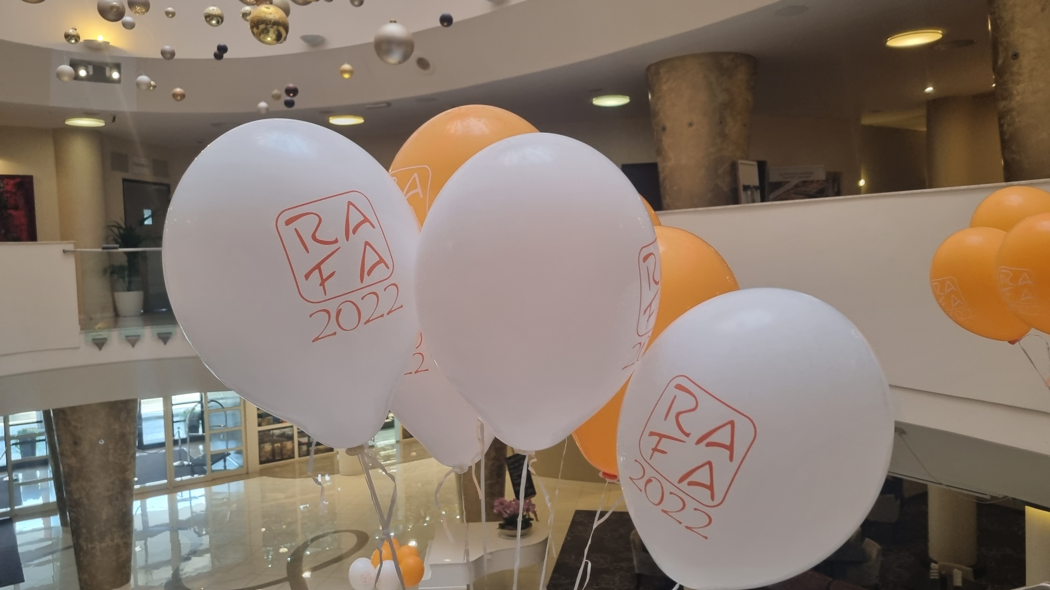


RAFA 2022
Highlights!

Slide 2

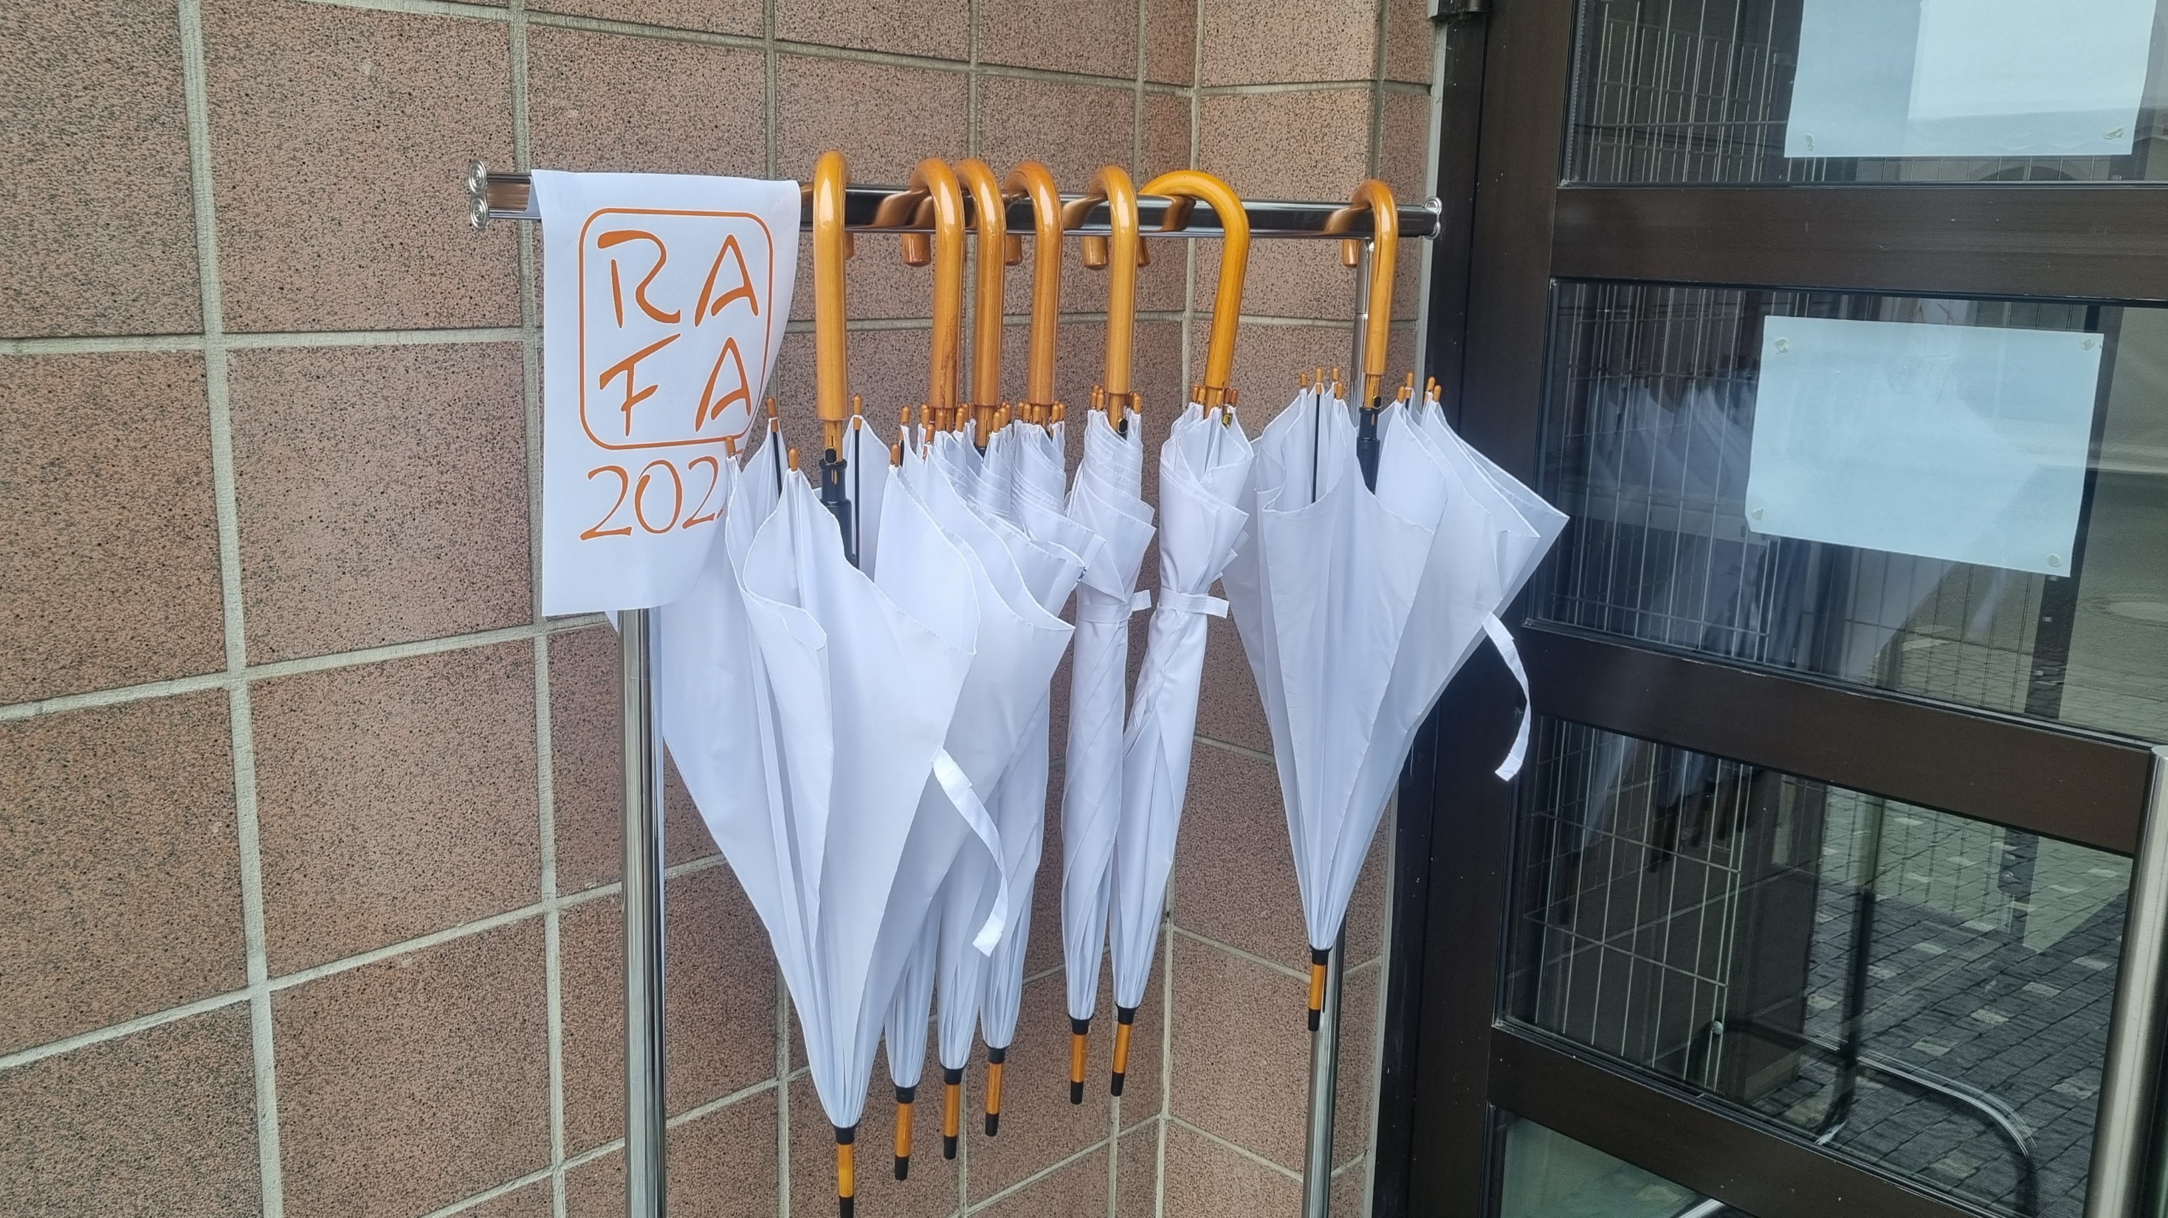




Slide 3

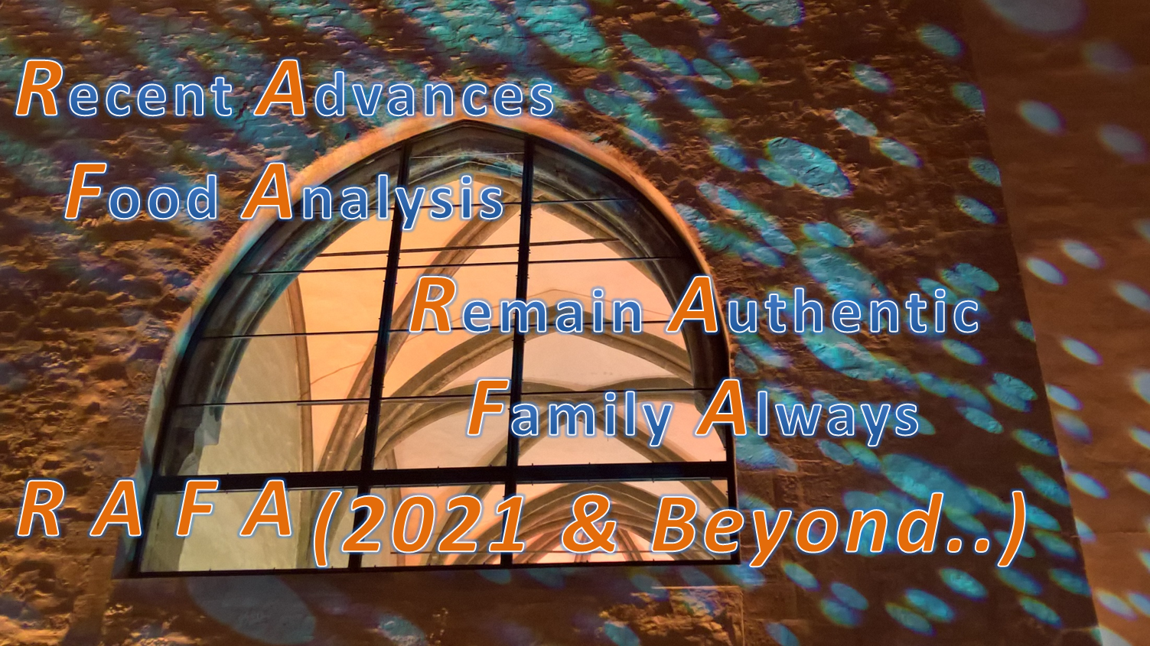

Slide 4

But…Families need to get together…

Slide 5
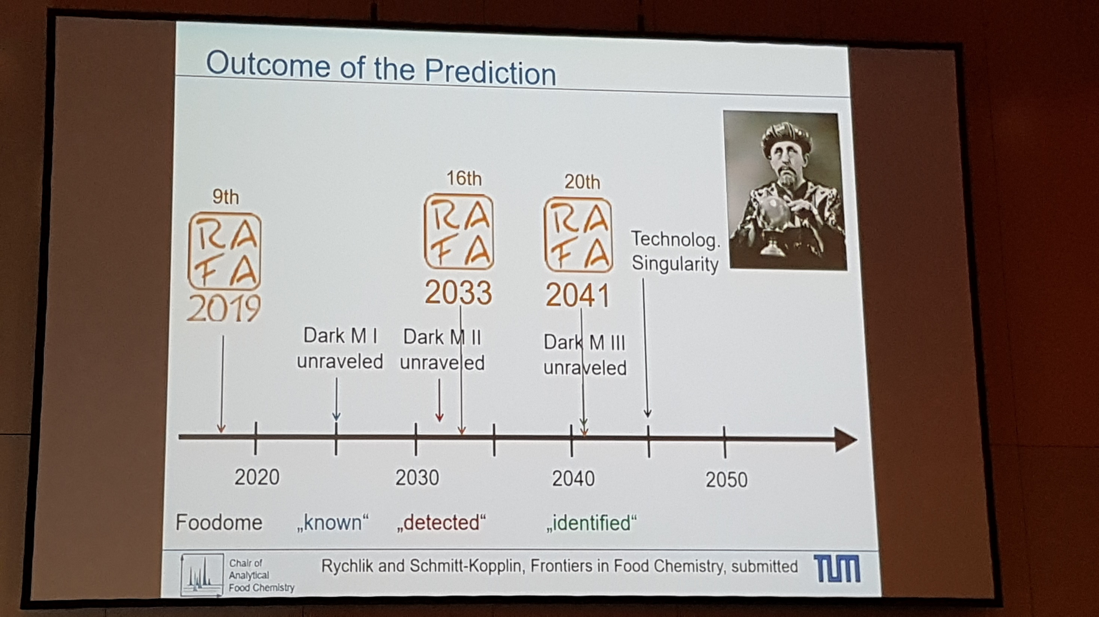


Slide 6

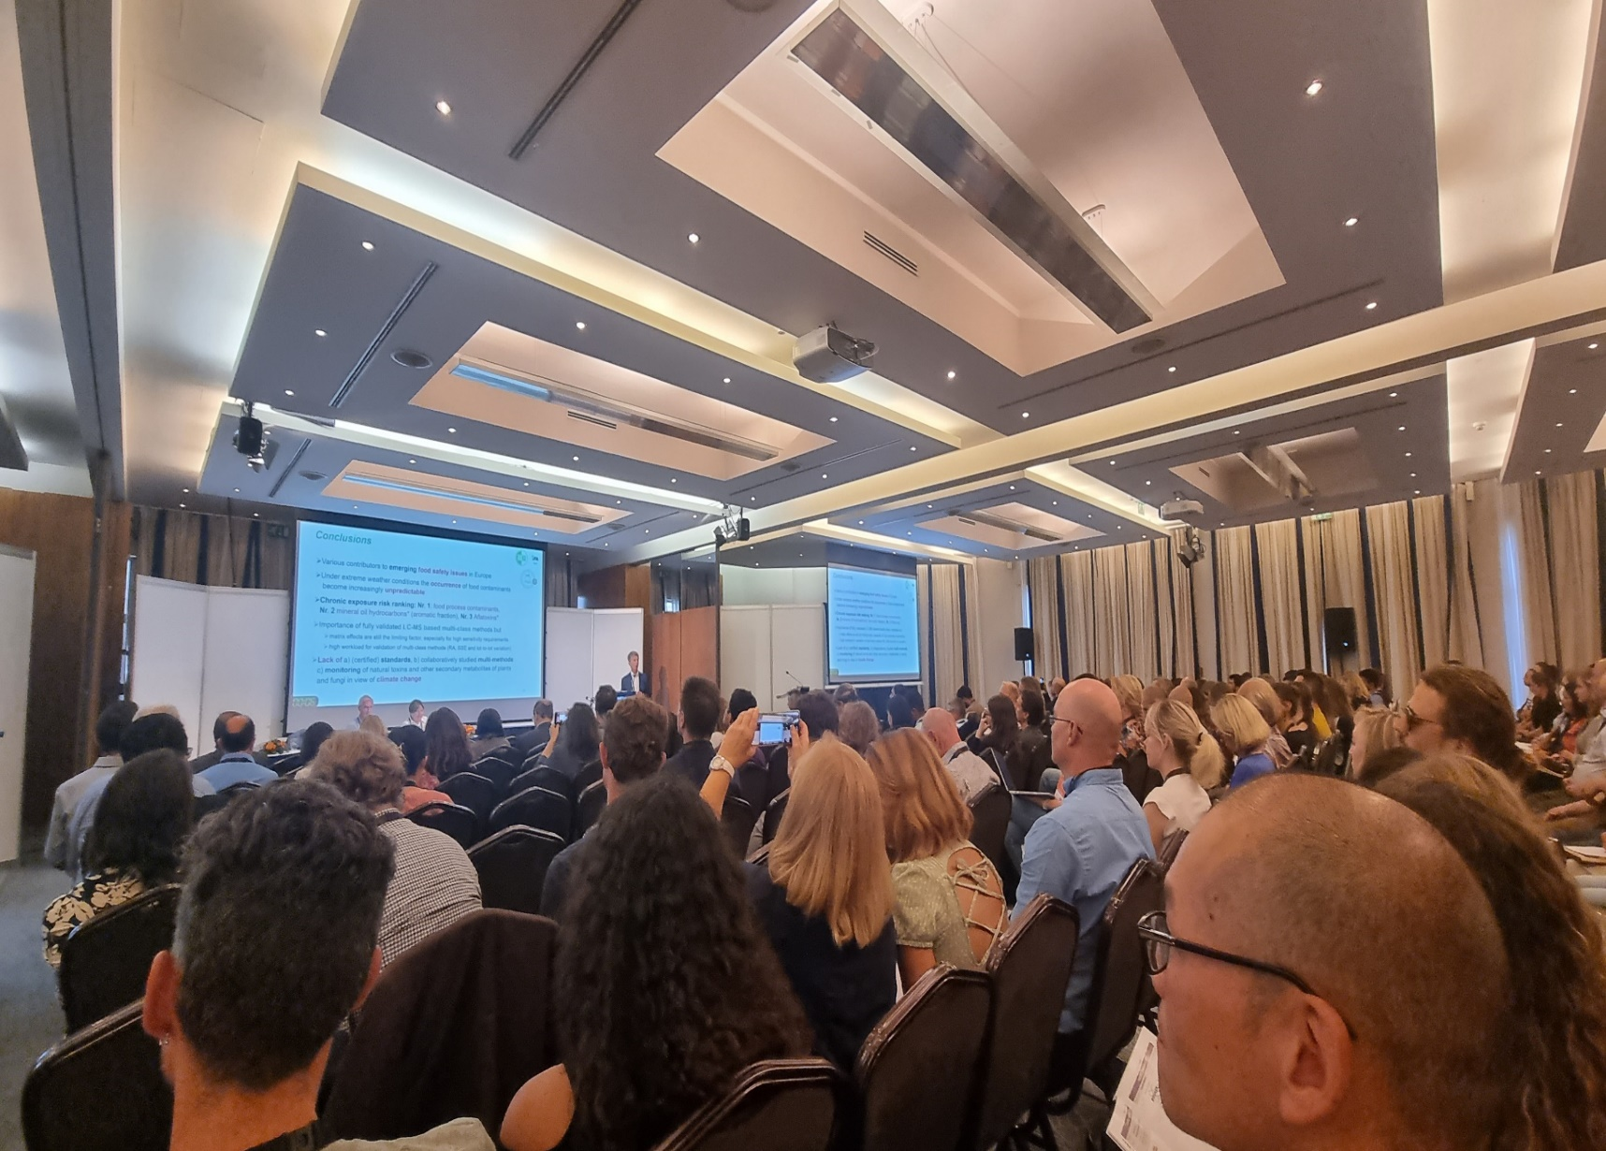
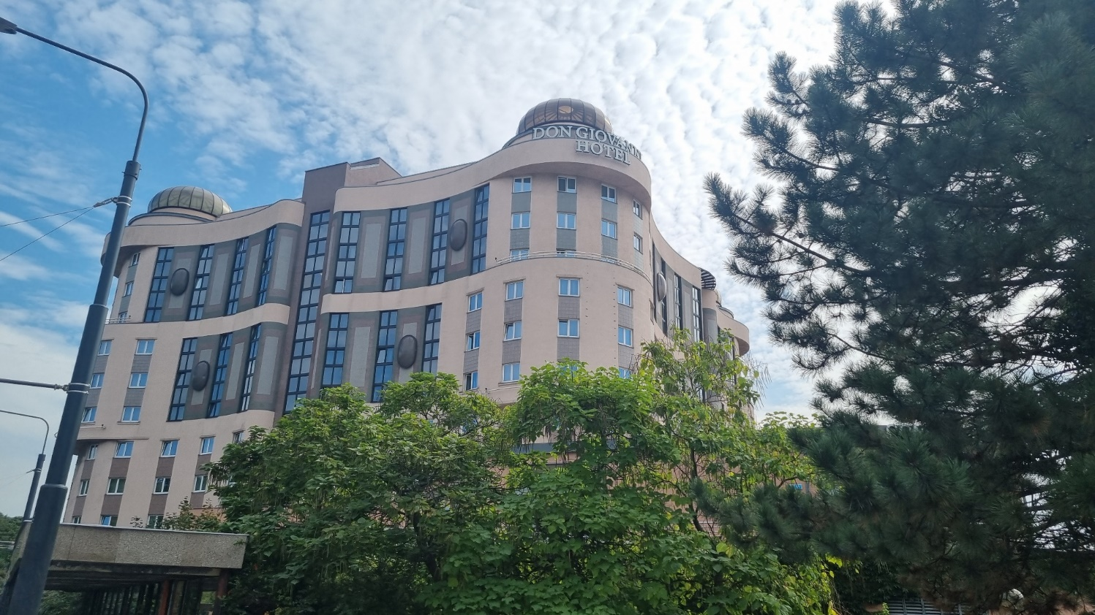
And in fact…
We Did IT!!! Again!!!

Slide 7

We arrived in the so beautiful Prague…

Slide 8
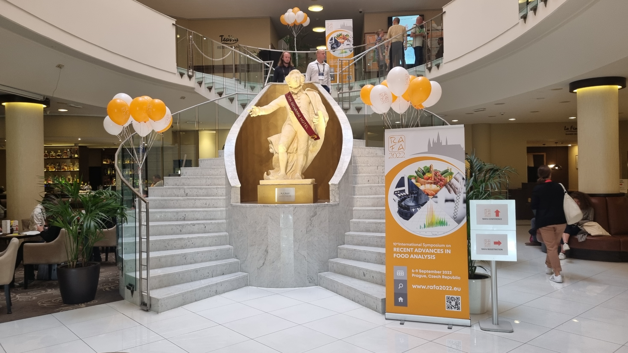
We went up to the new stairs…

Slide 9
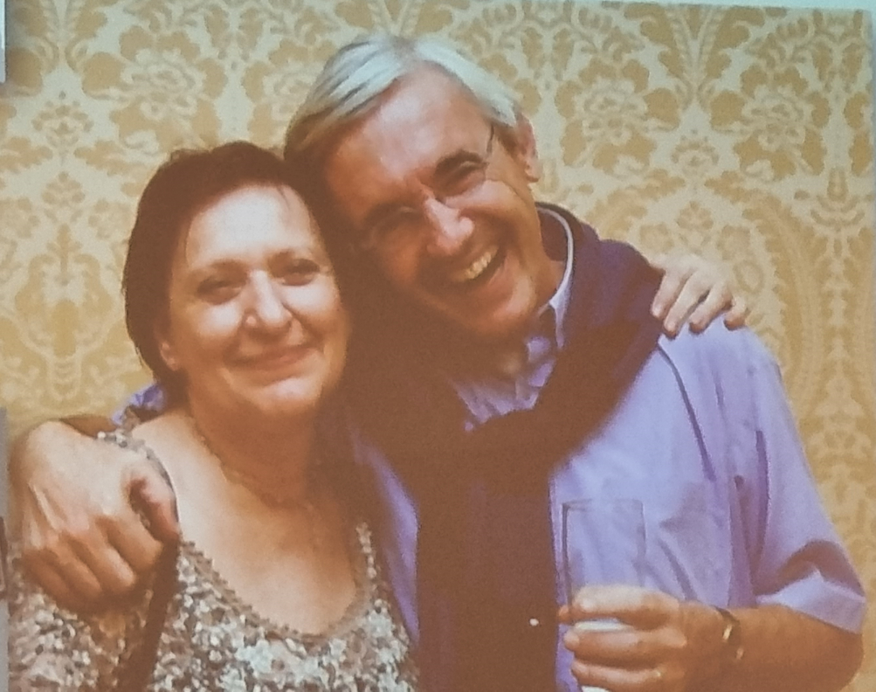
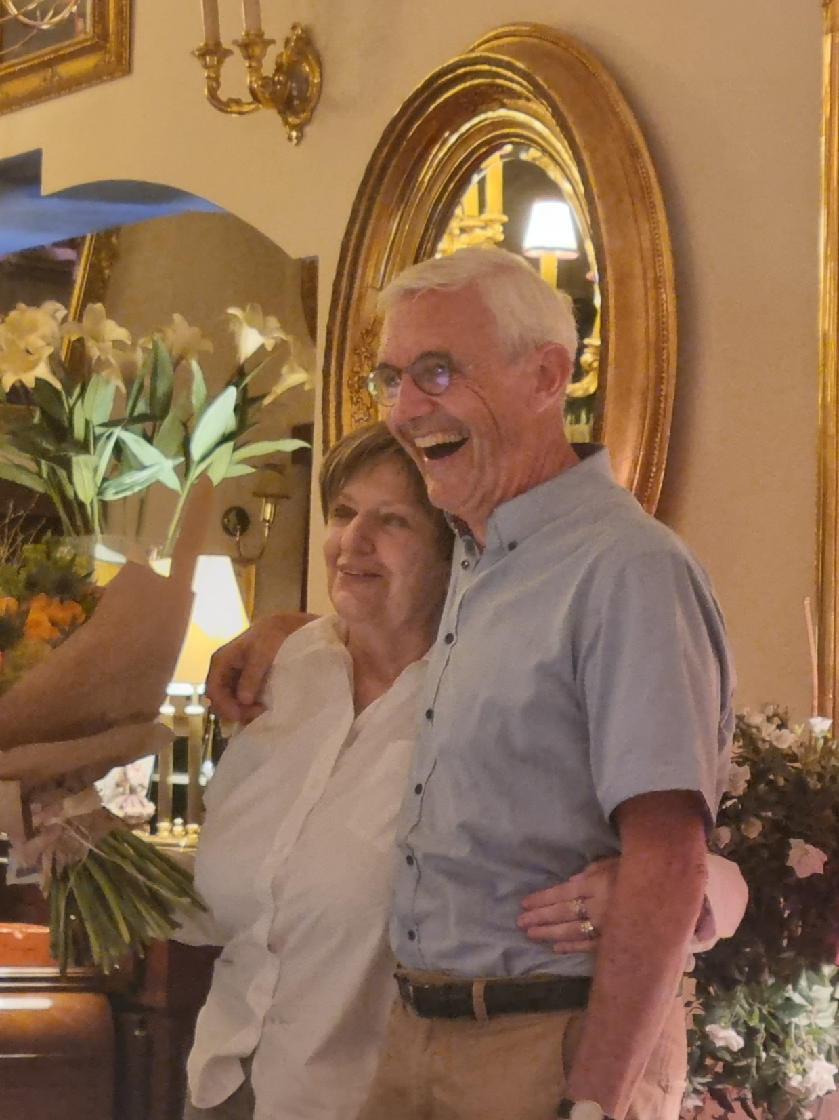
…and we’ve found this two guys…always with the same smile!!!

Slide 10
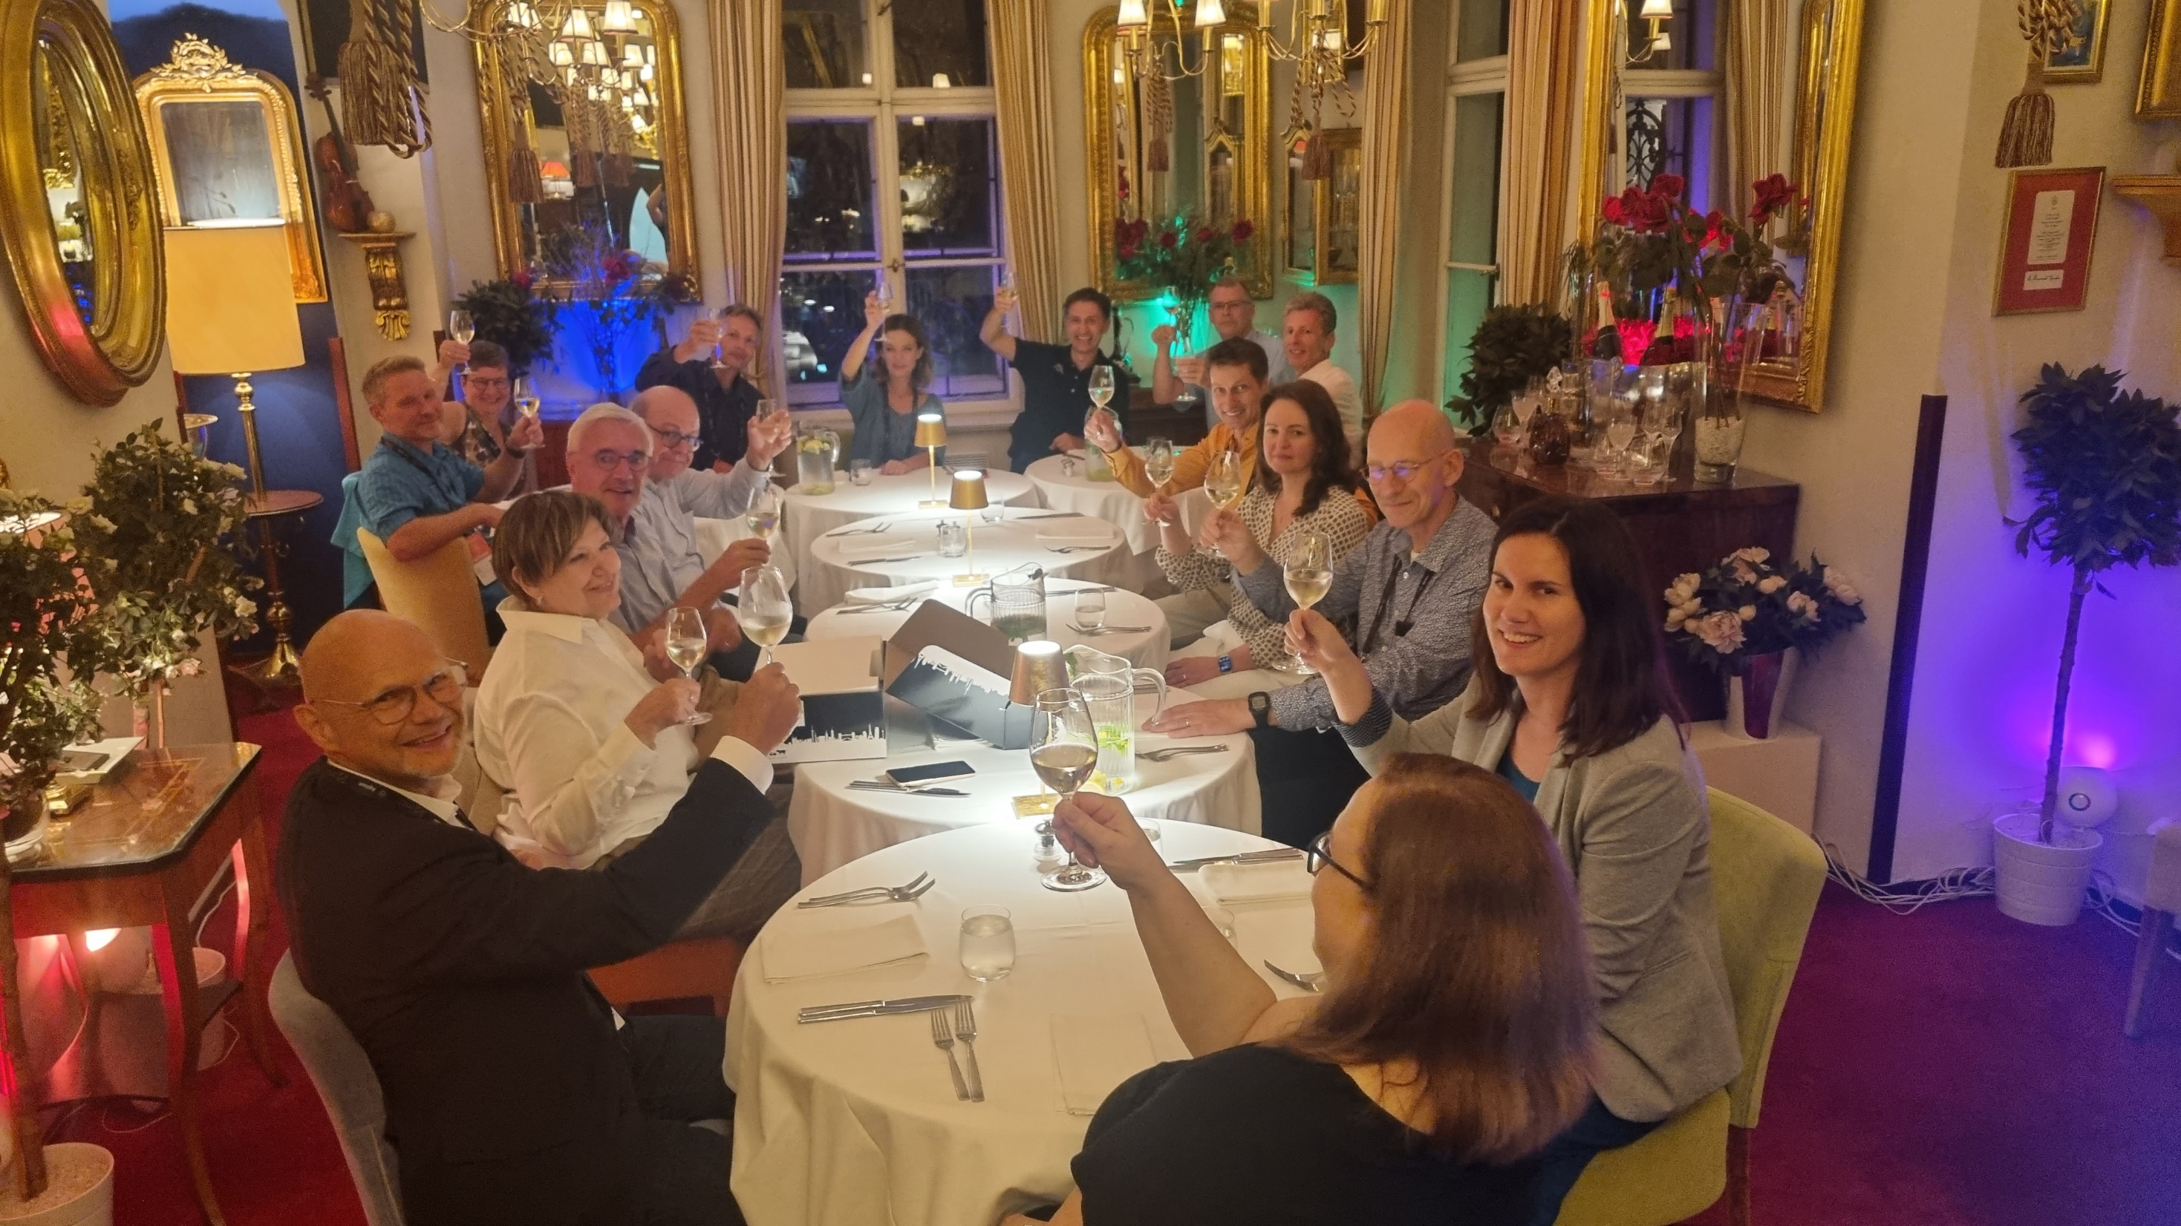
A Scientific Committee always working…

Slide 11
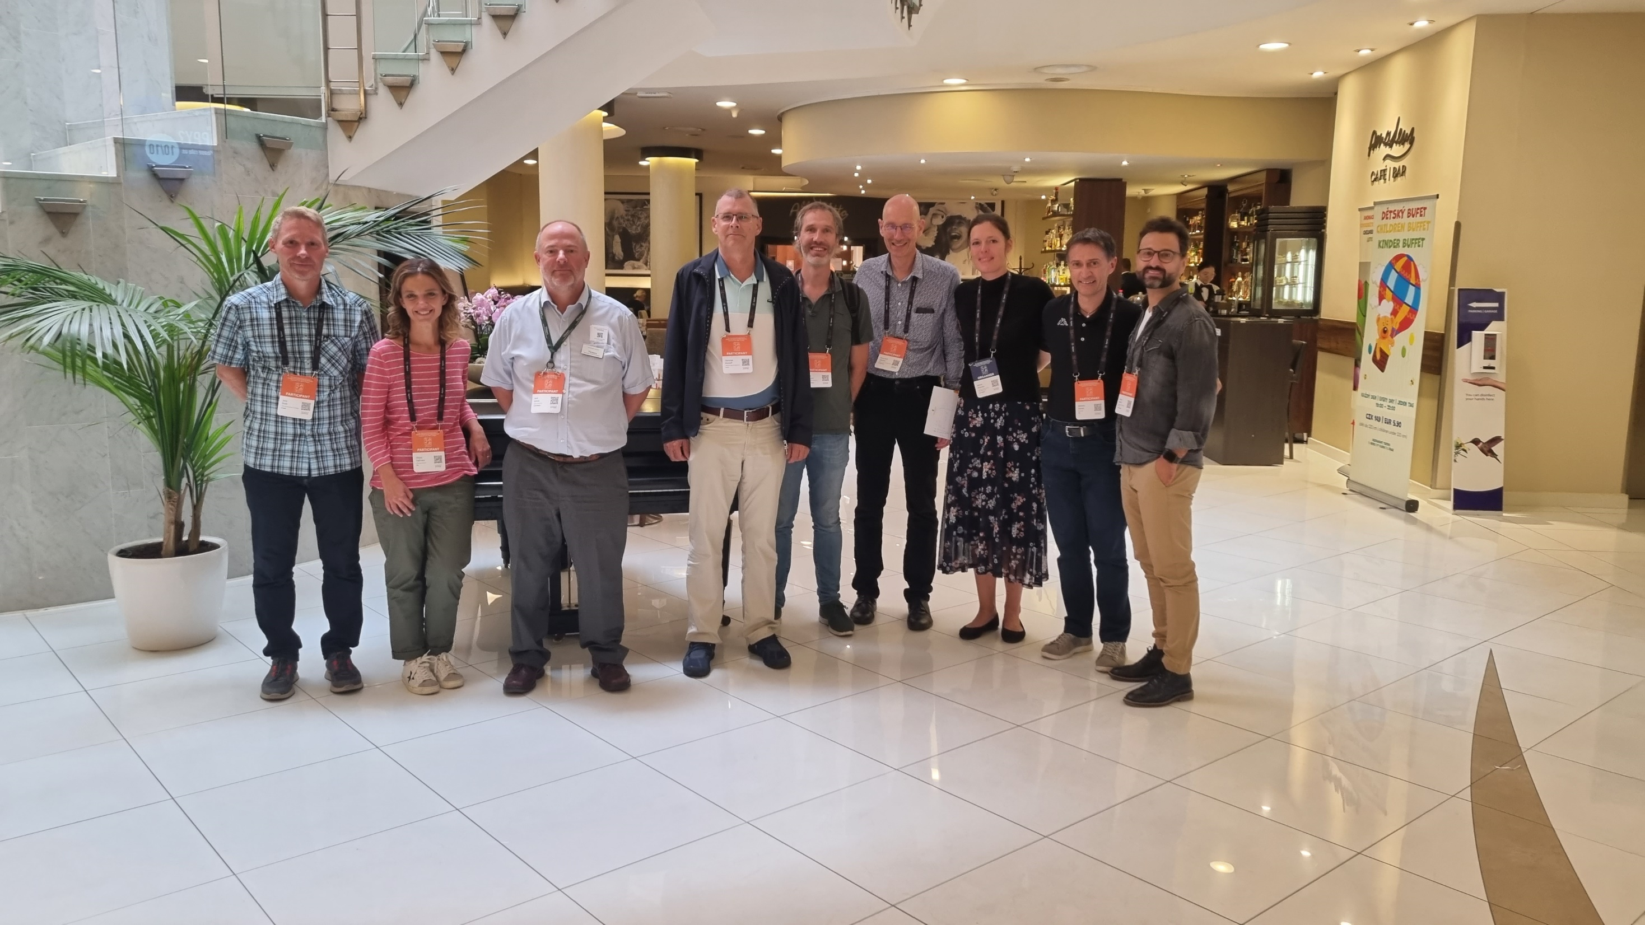
A Poster Committee always working…

Slide 12
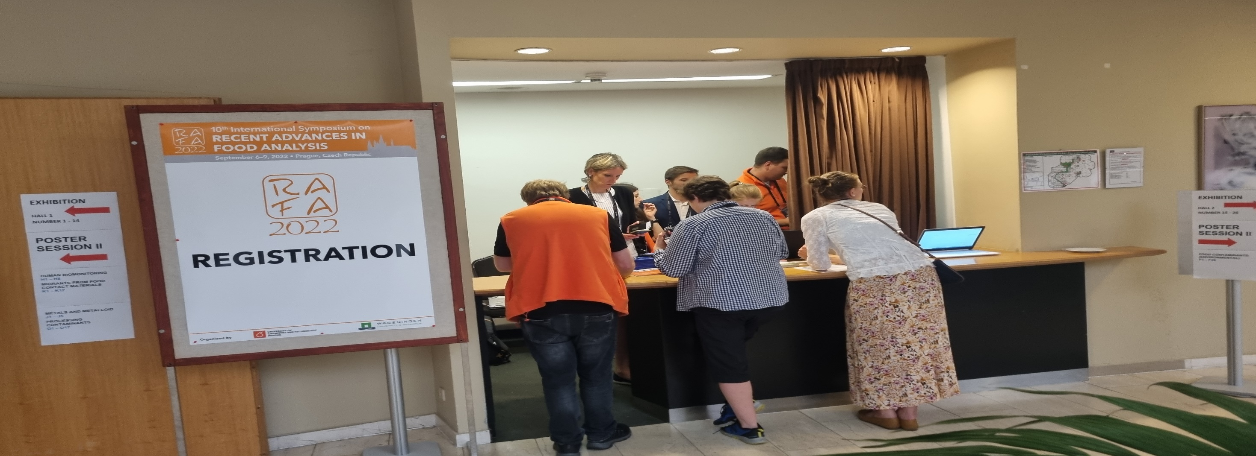

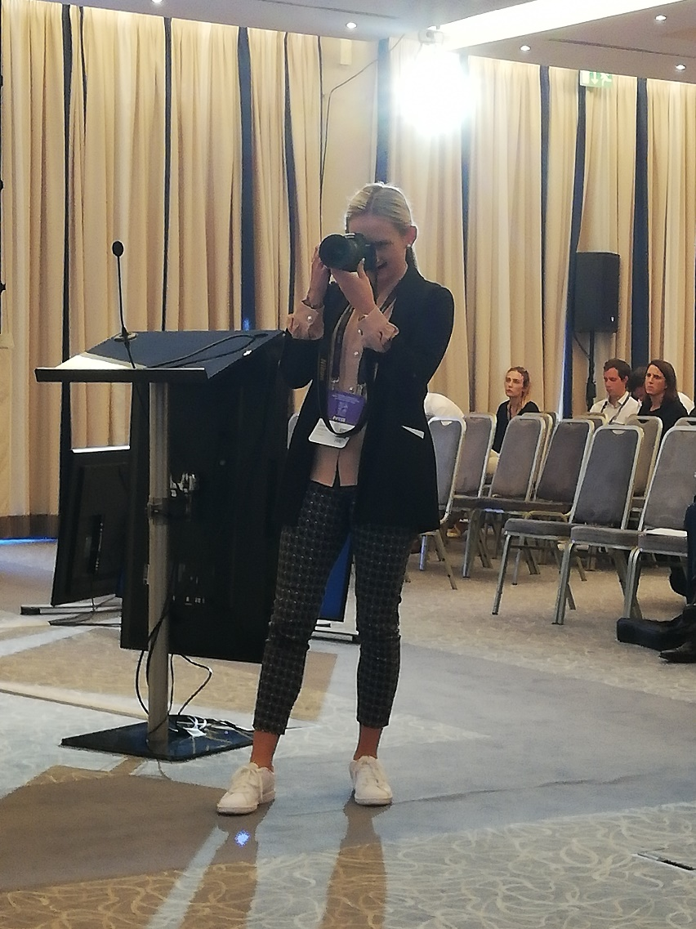
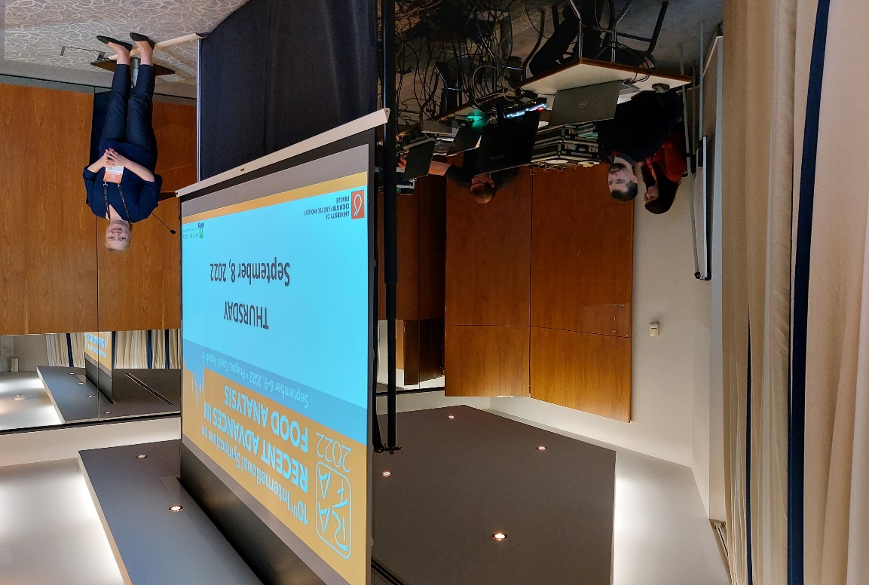
A number of Angels always helping us…

Slide 13
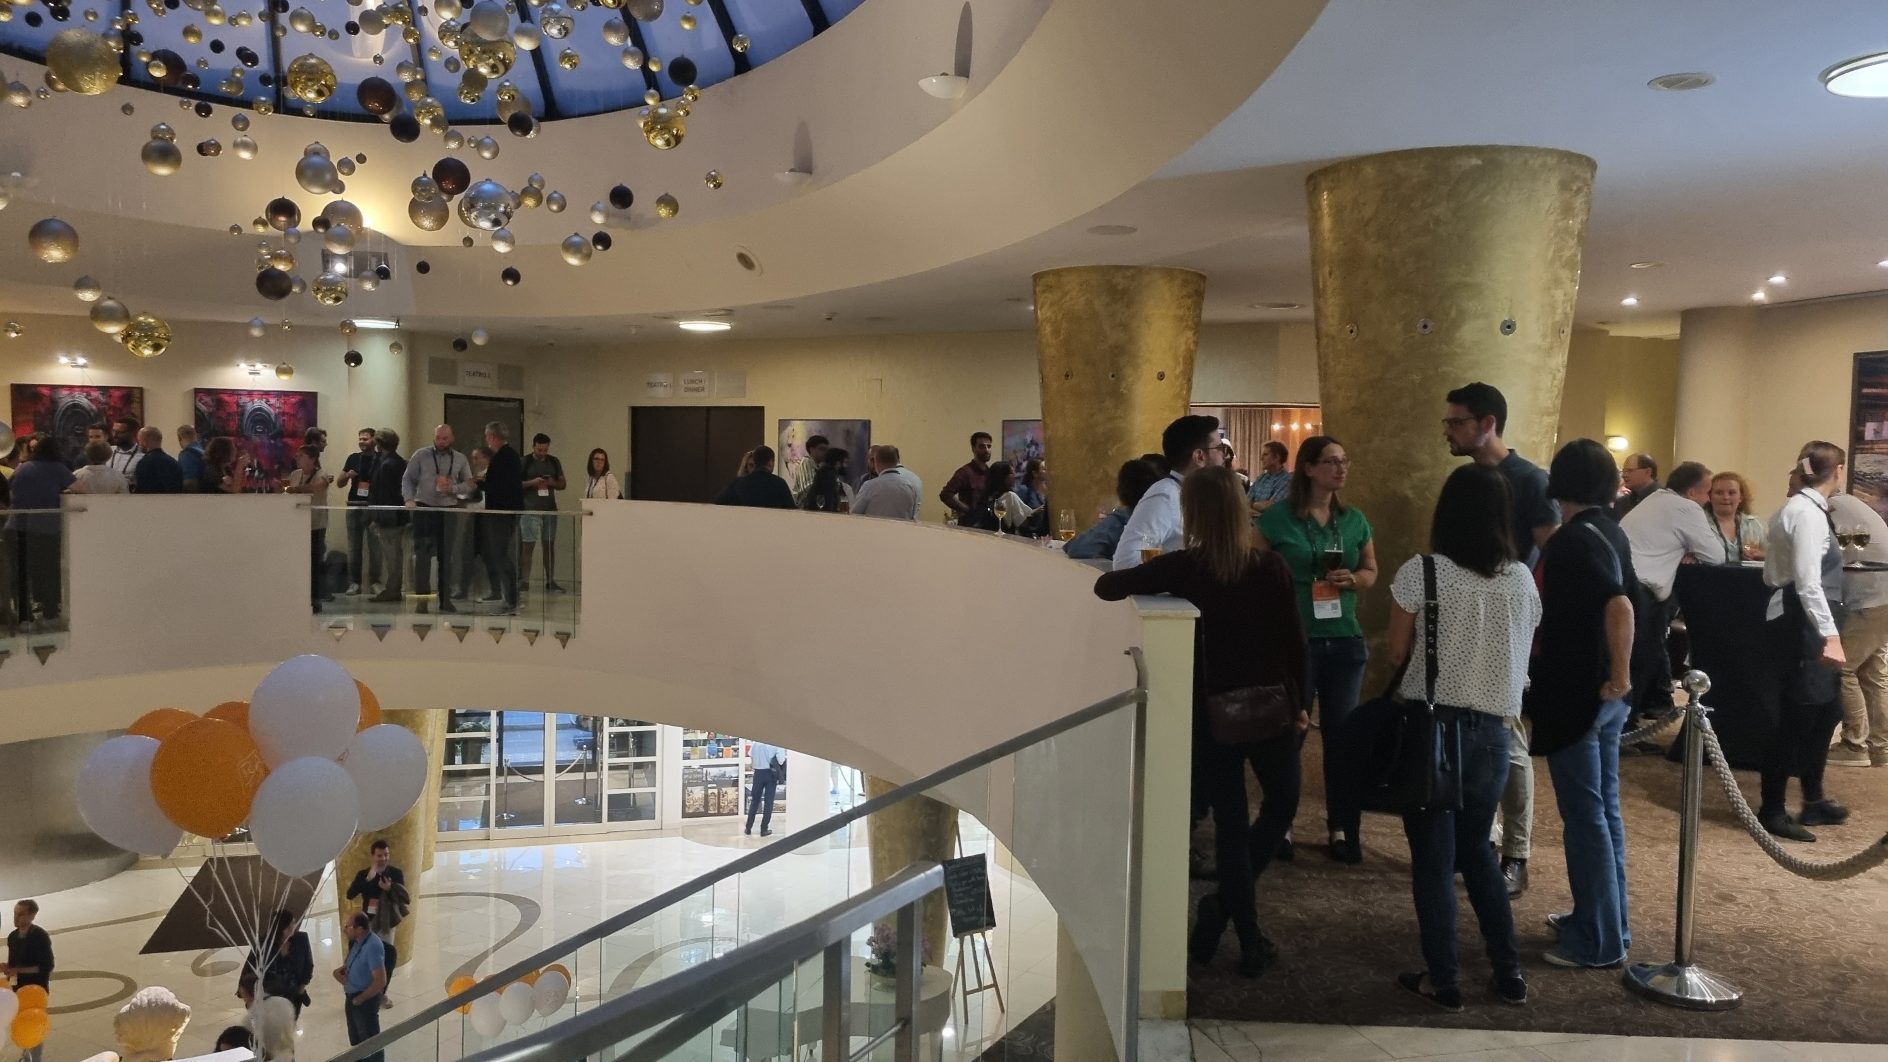
A number of Friends always missing…

Slide 14
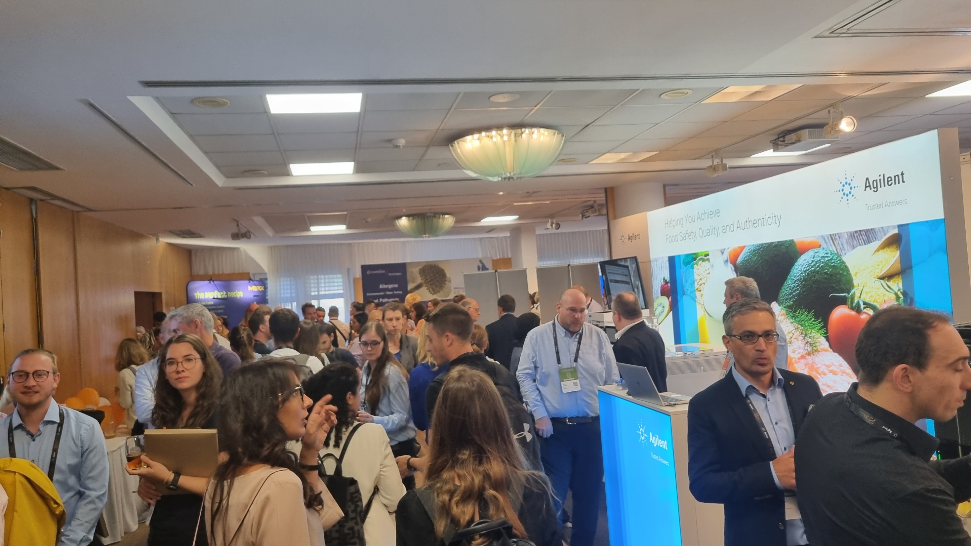
Because…RAFA is for Everyone…

Slide 15
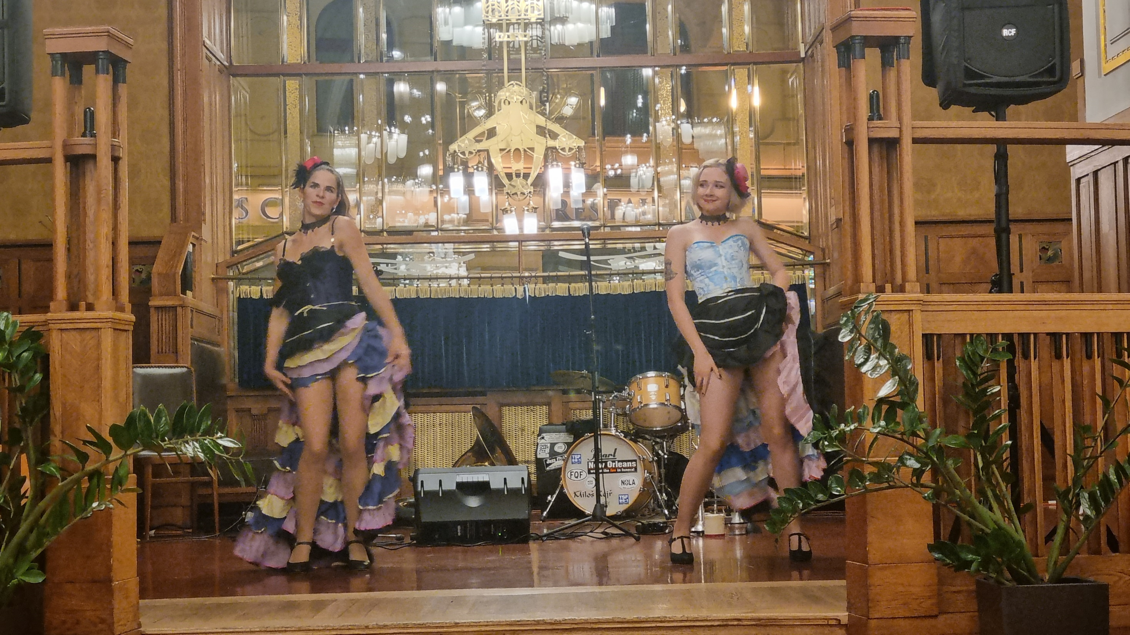


…RAFA is for Adults…Oooops!

Slide 16
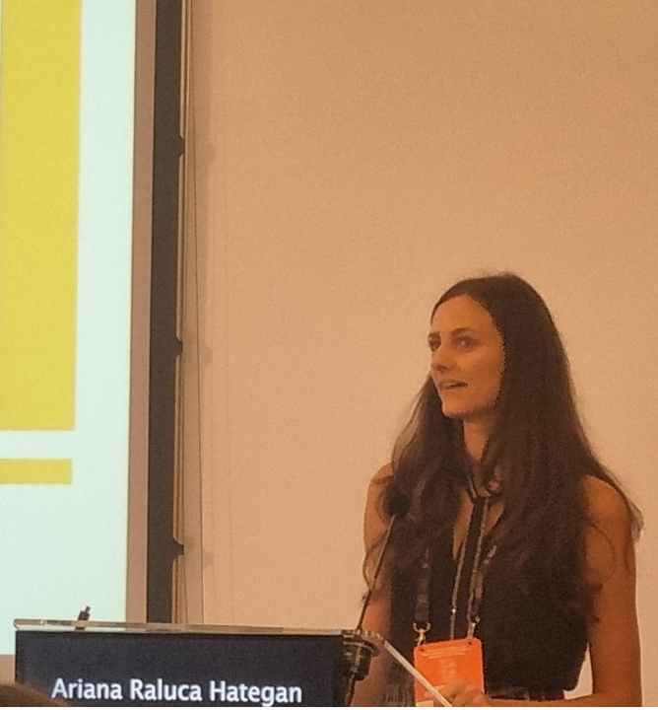
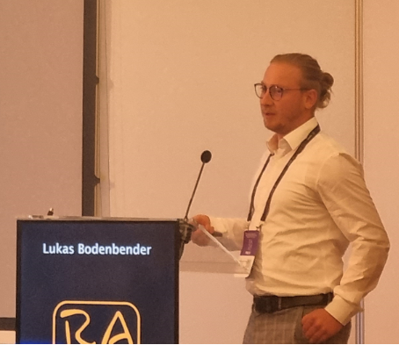
…RAFA is for Young…

Slide 17
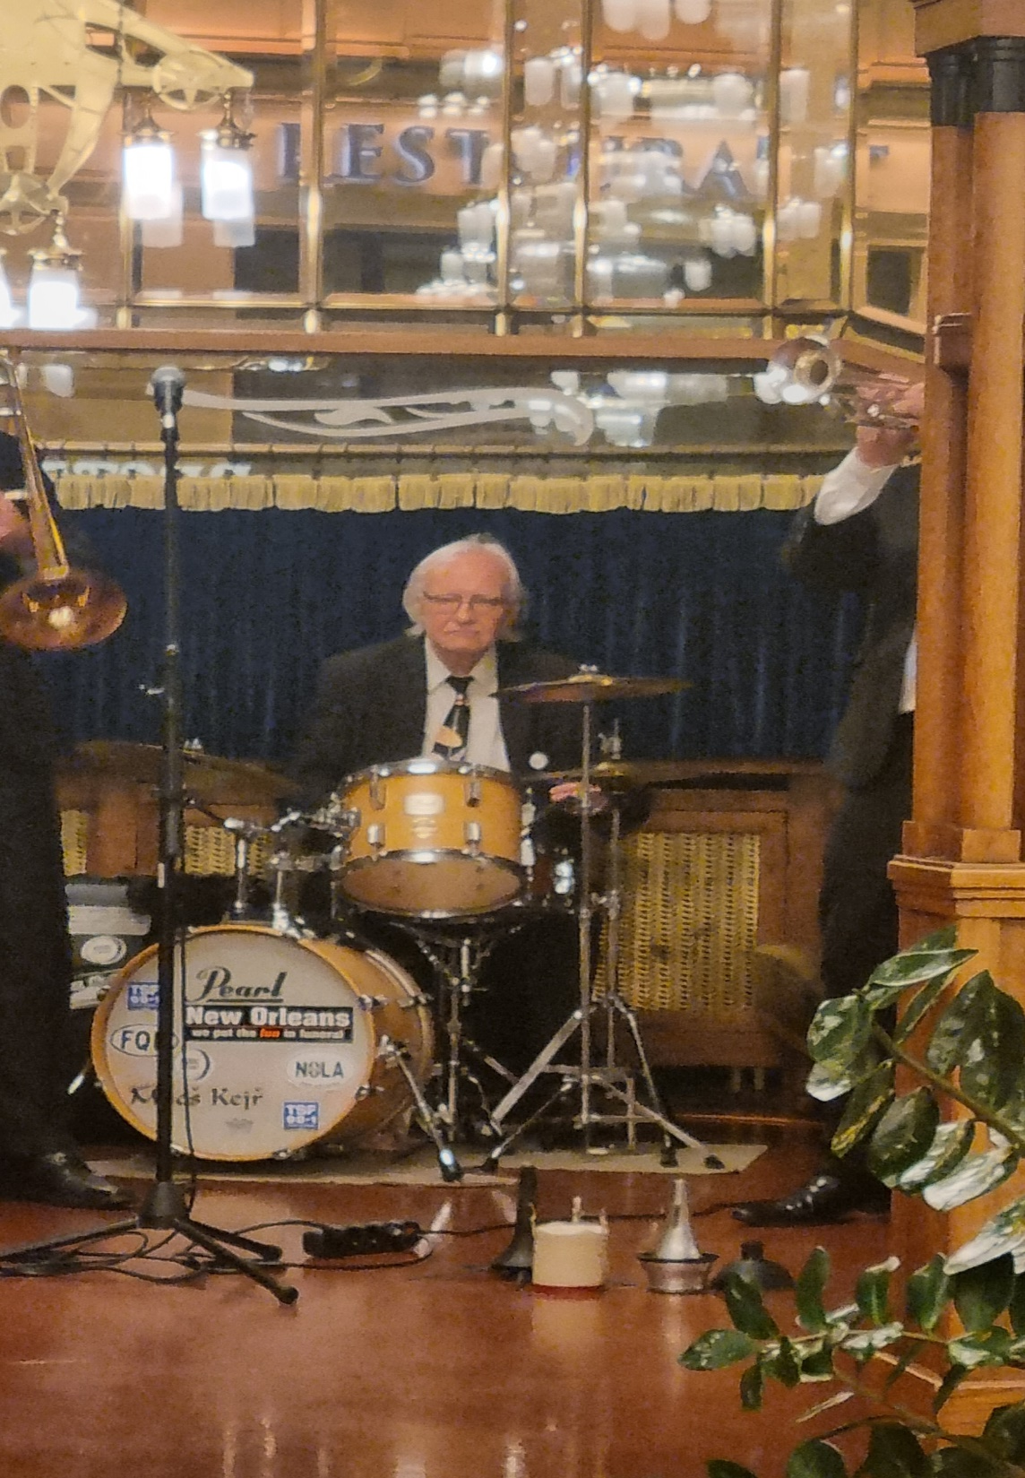
…and also…
Less Young…

Slide 18

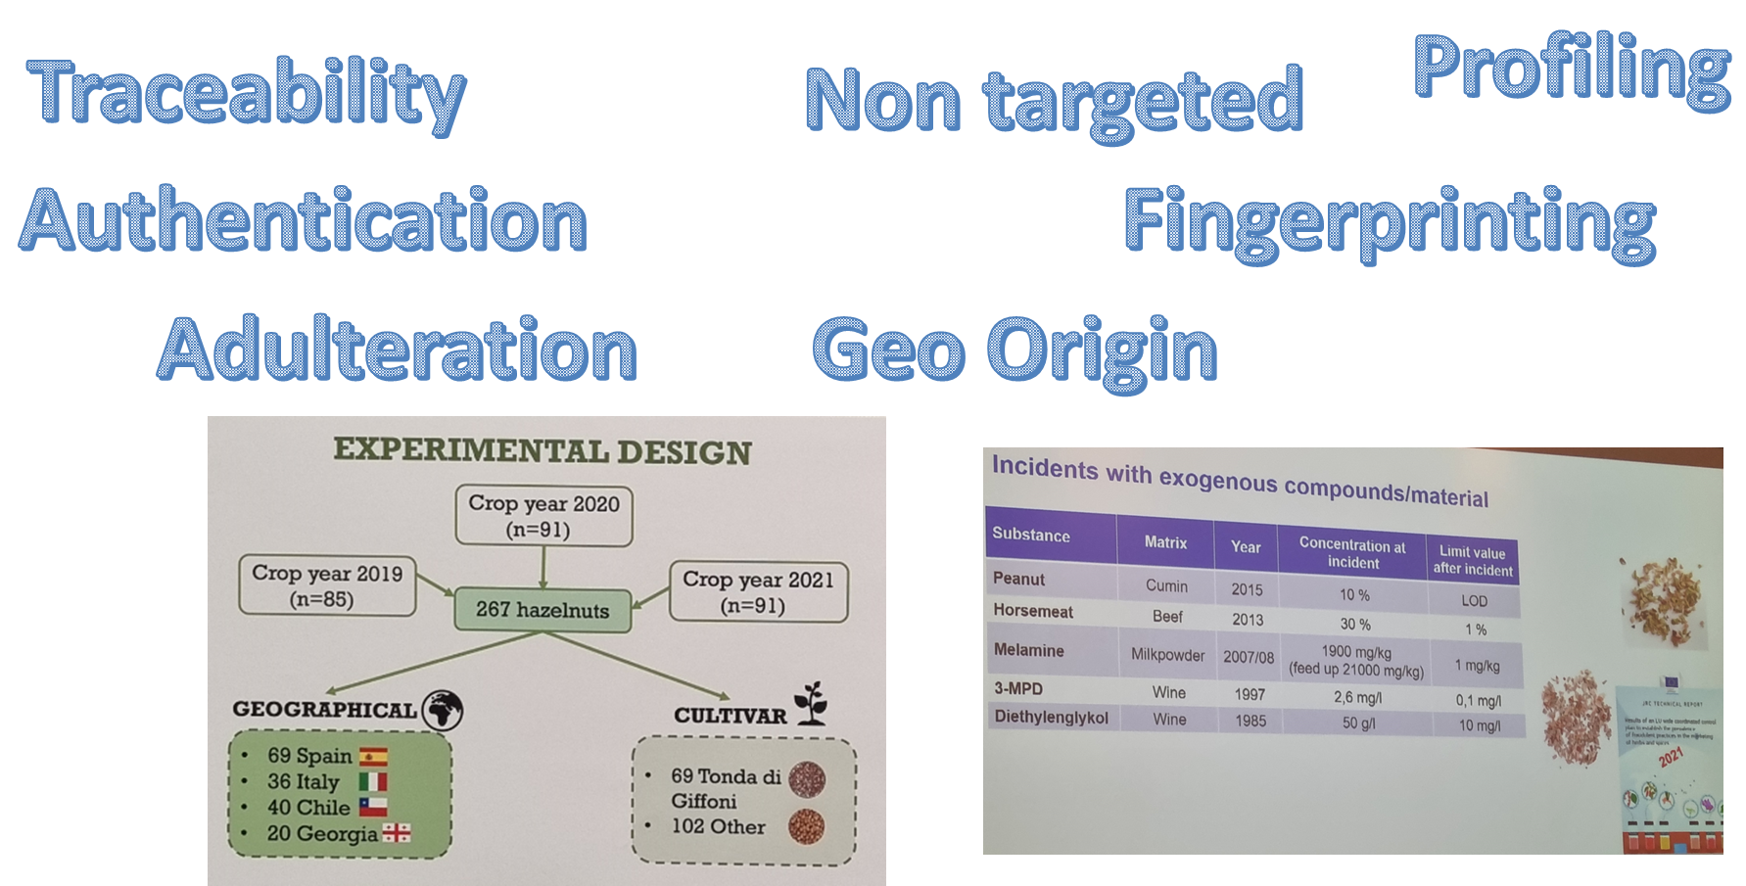
RAFA 2022 KEYWORDS

Slide 19
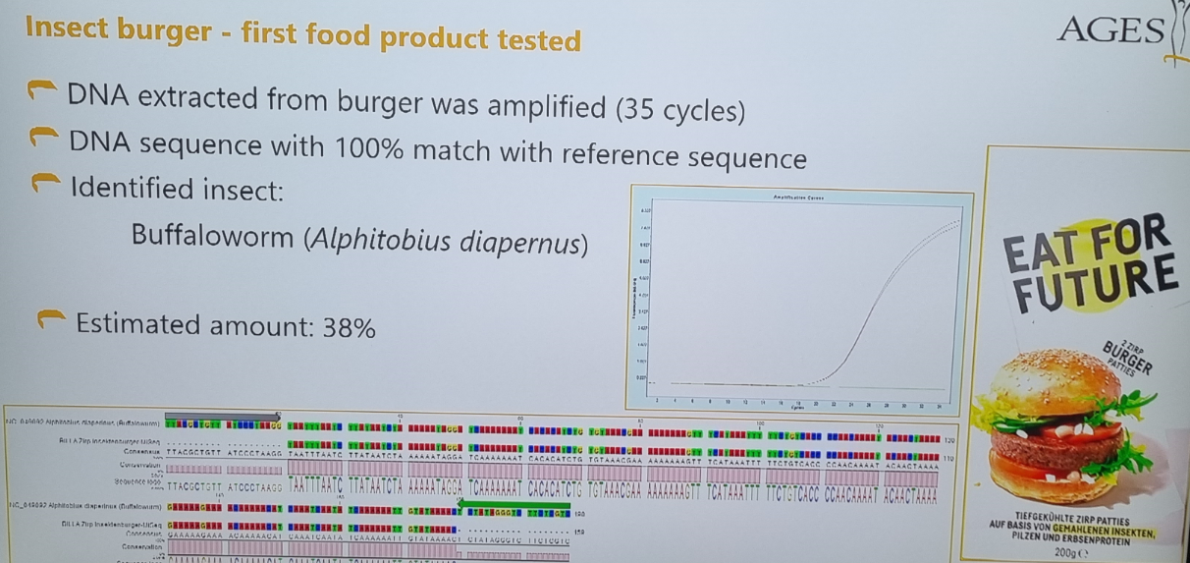
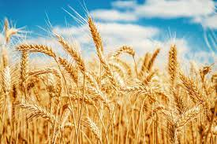
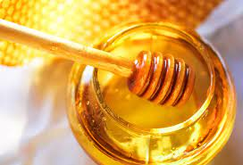
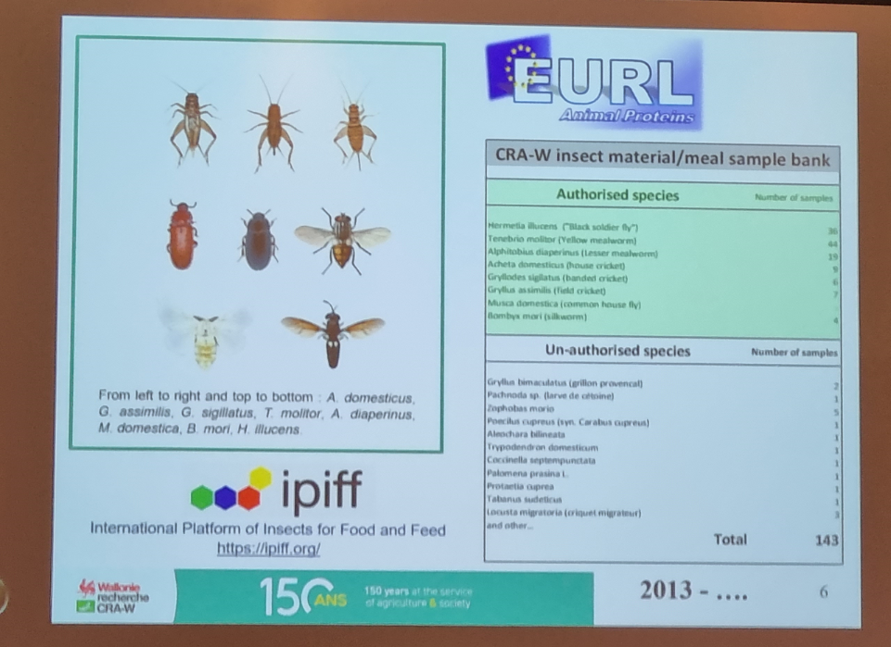
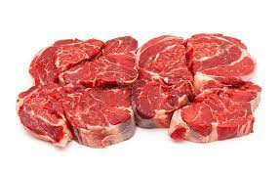

RAFA 2022 KEYWORDS
Meat
Honey
Wheat
Water
Insects

Slide 20
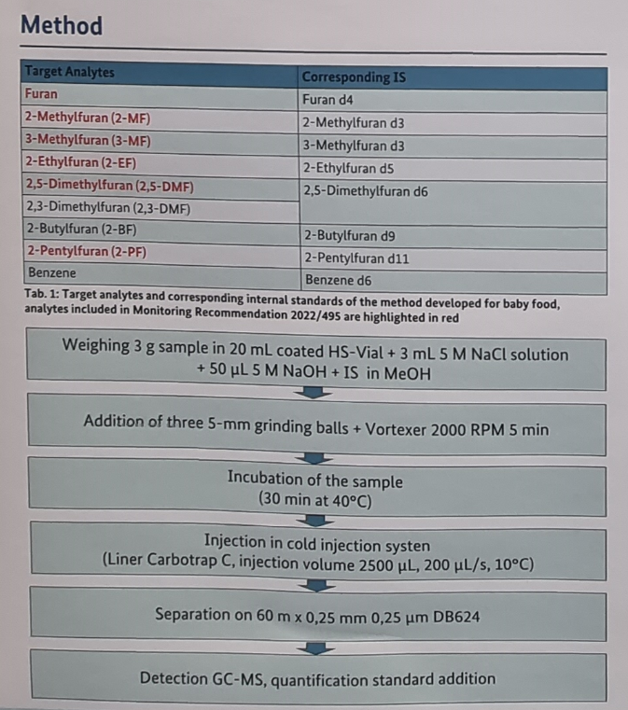
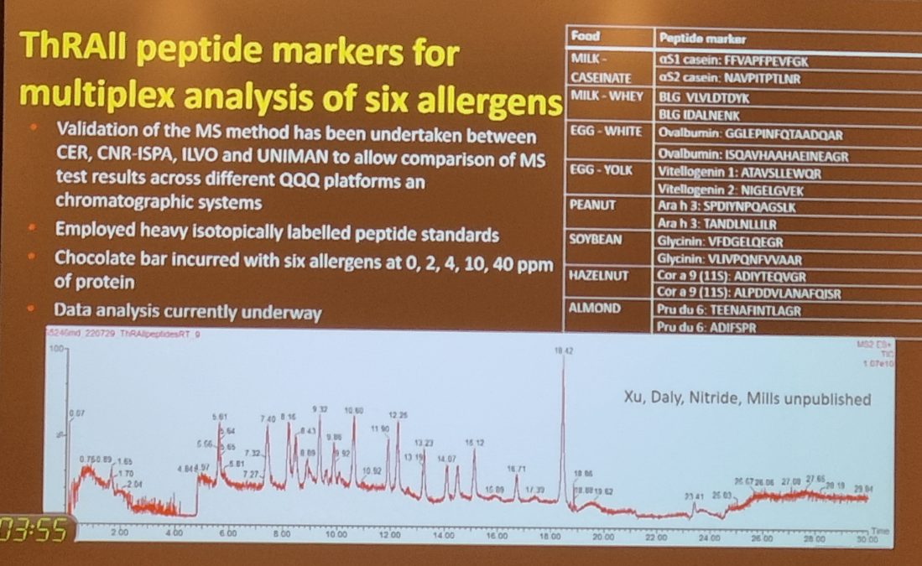
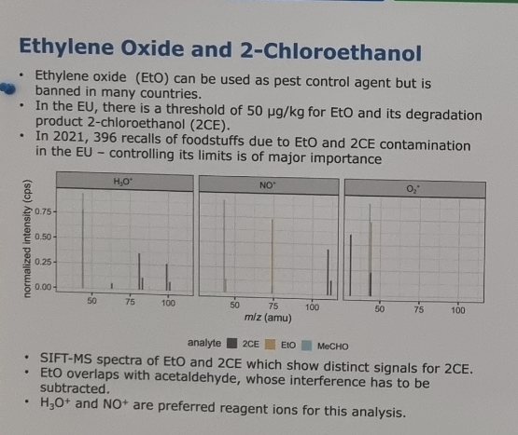
RAFA 2022 KEYWORDS
Furan
Acrylamide
MCPDs
Allergens
Cannabis
Pesticides
Ethylene Oxide
Mycotoxins/Plant Toxins

Slide 21
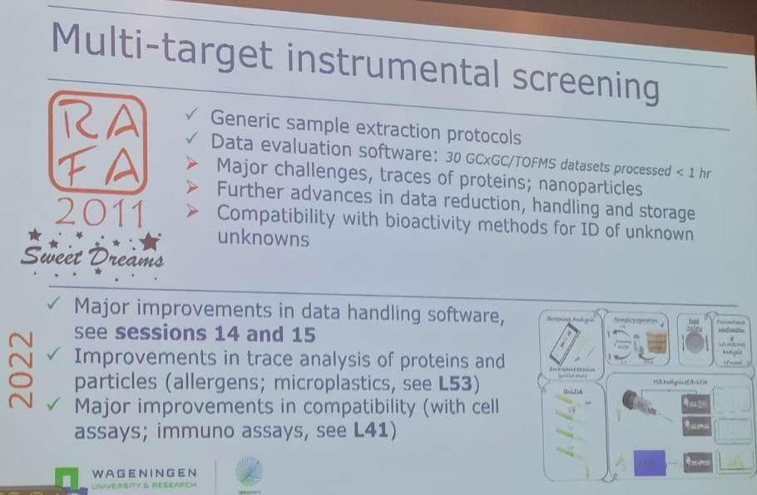
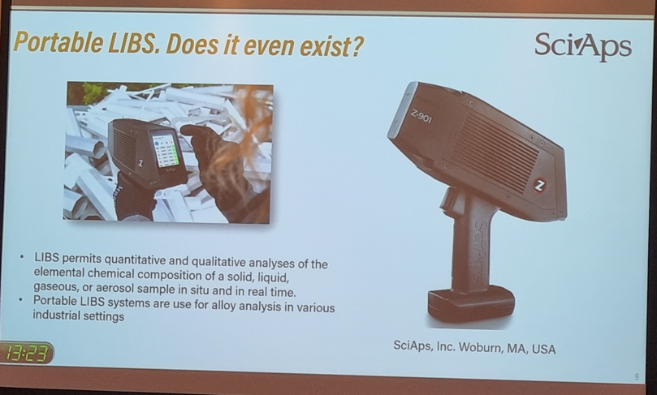
RAFA 2022 KEYWORDS
Proficiency testing
«Multi»…
Screening
Validation
Portable/On-site

Slide 22
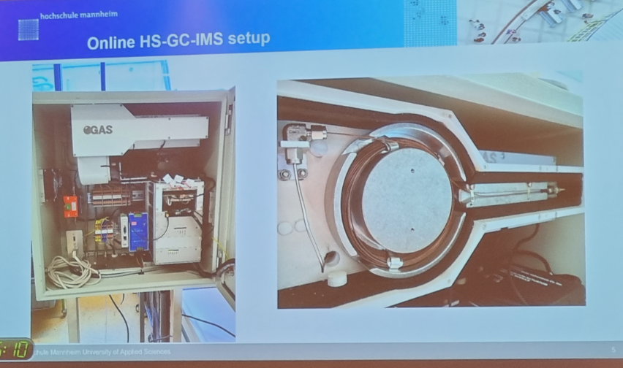
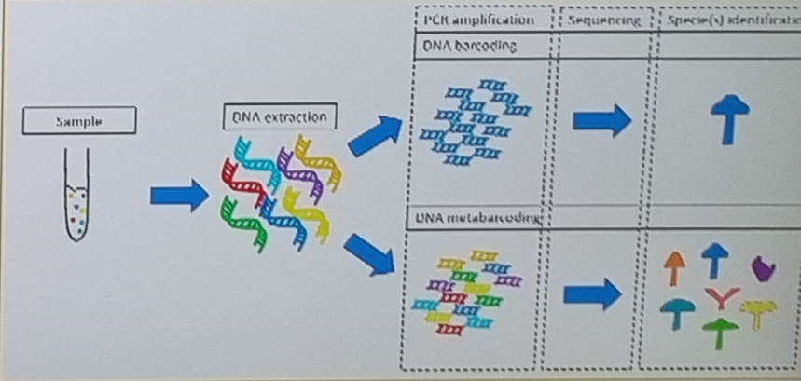
RAFA 2022 KEYWORDS
Ambient/High Res Mass Spectrometry
Ion Mobility Mass Spectrometry/Spectroscopy
DNA Metabarcoding

Slide 23
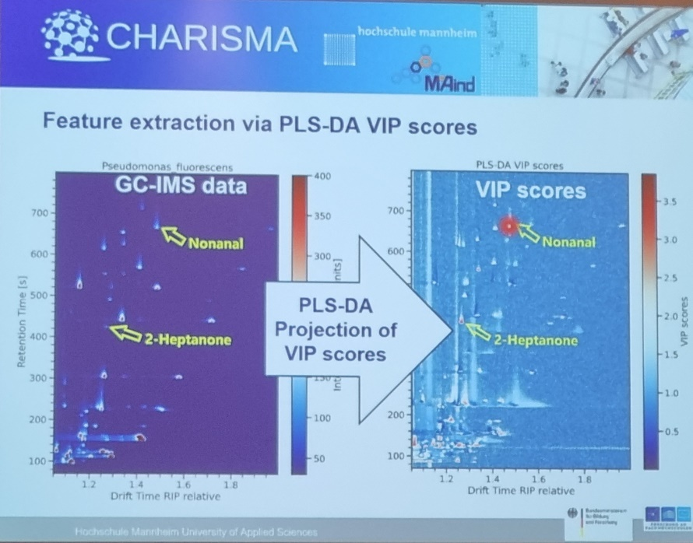
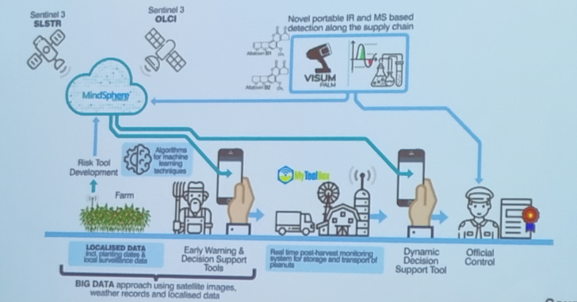
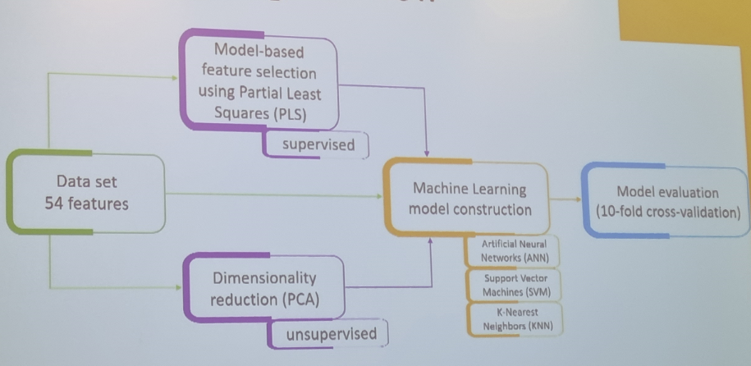
RAFA 2022 KEYWORDS
Metabolomics
Proteomics
Biomonitoring
Machine Learning
Artificial Intelligence

Slide 24
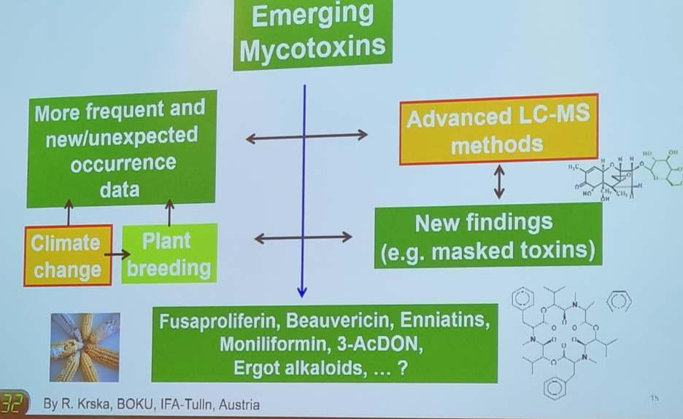
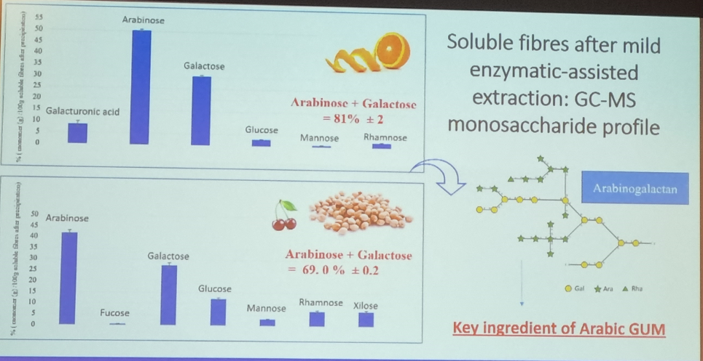
RAFA 2022 KEYWORDS
Regulation
Consumers
Circular Economy
Climate Change

Slide 25
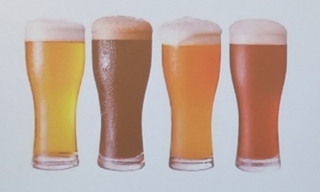
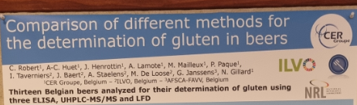
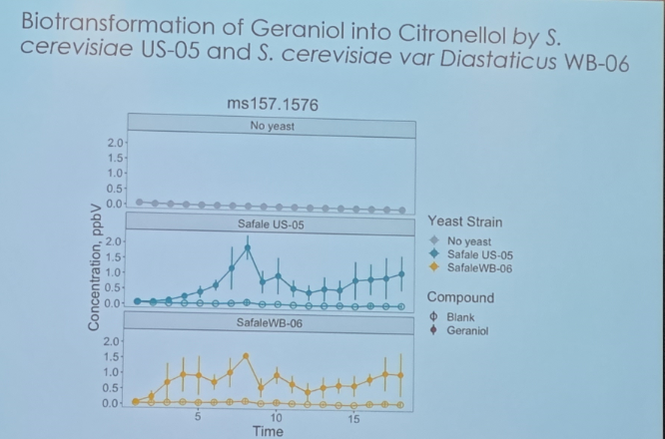
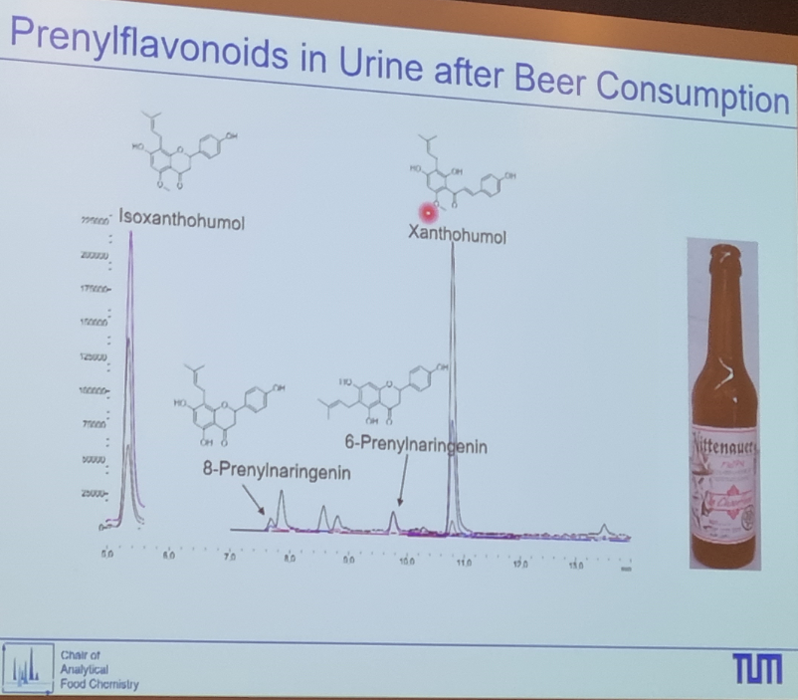
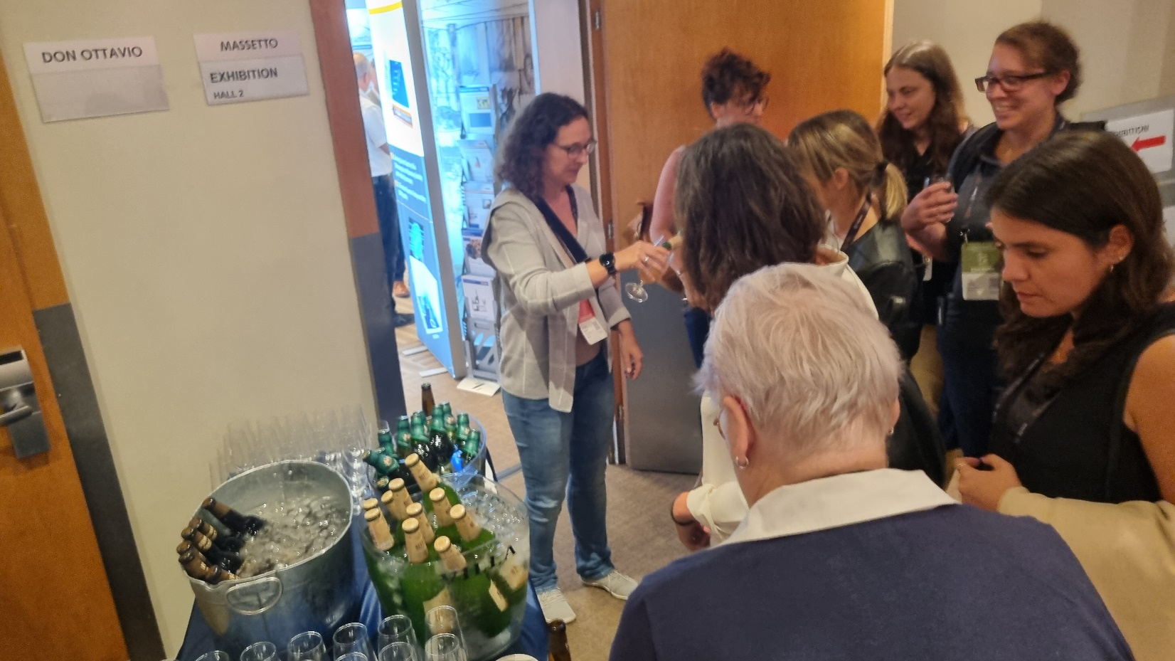
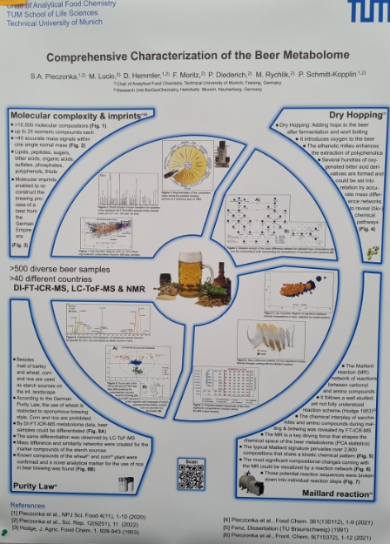
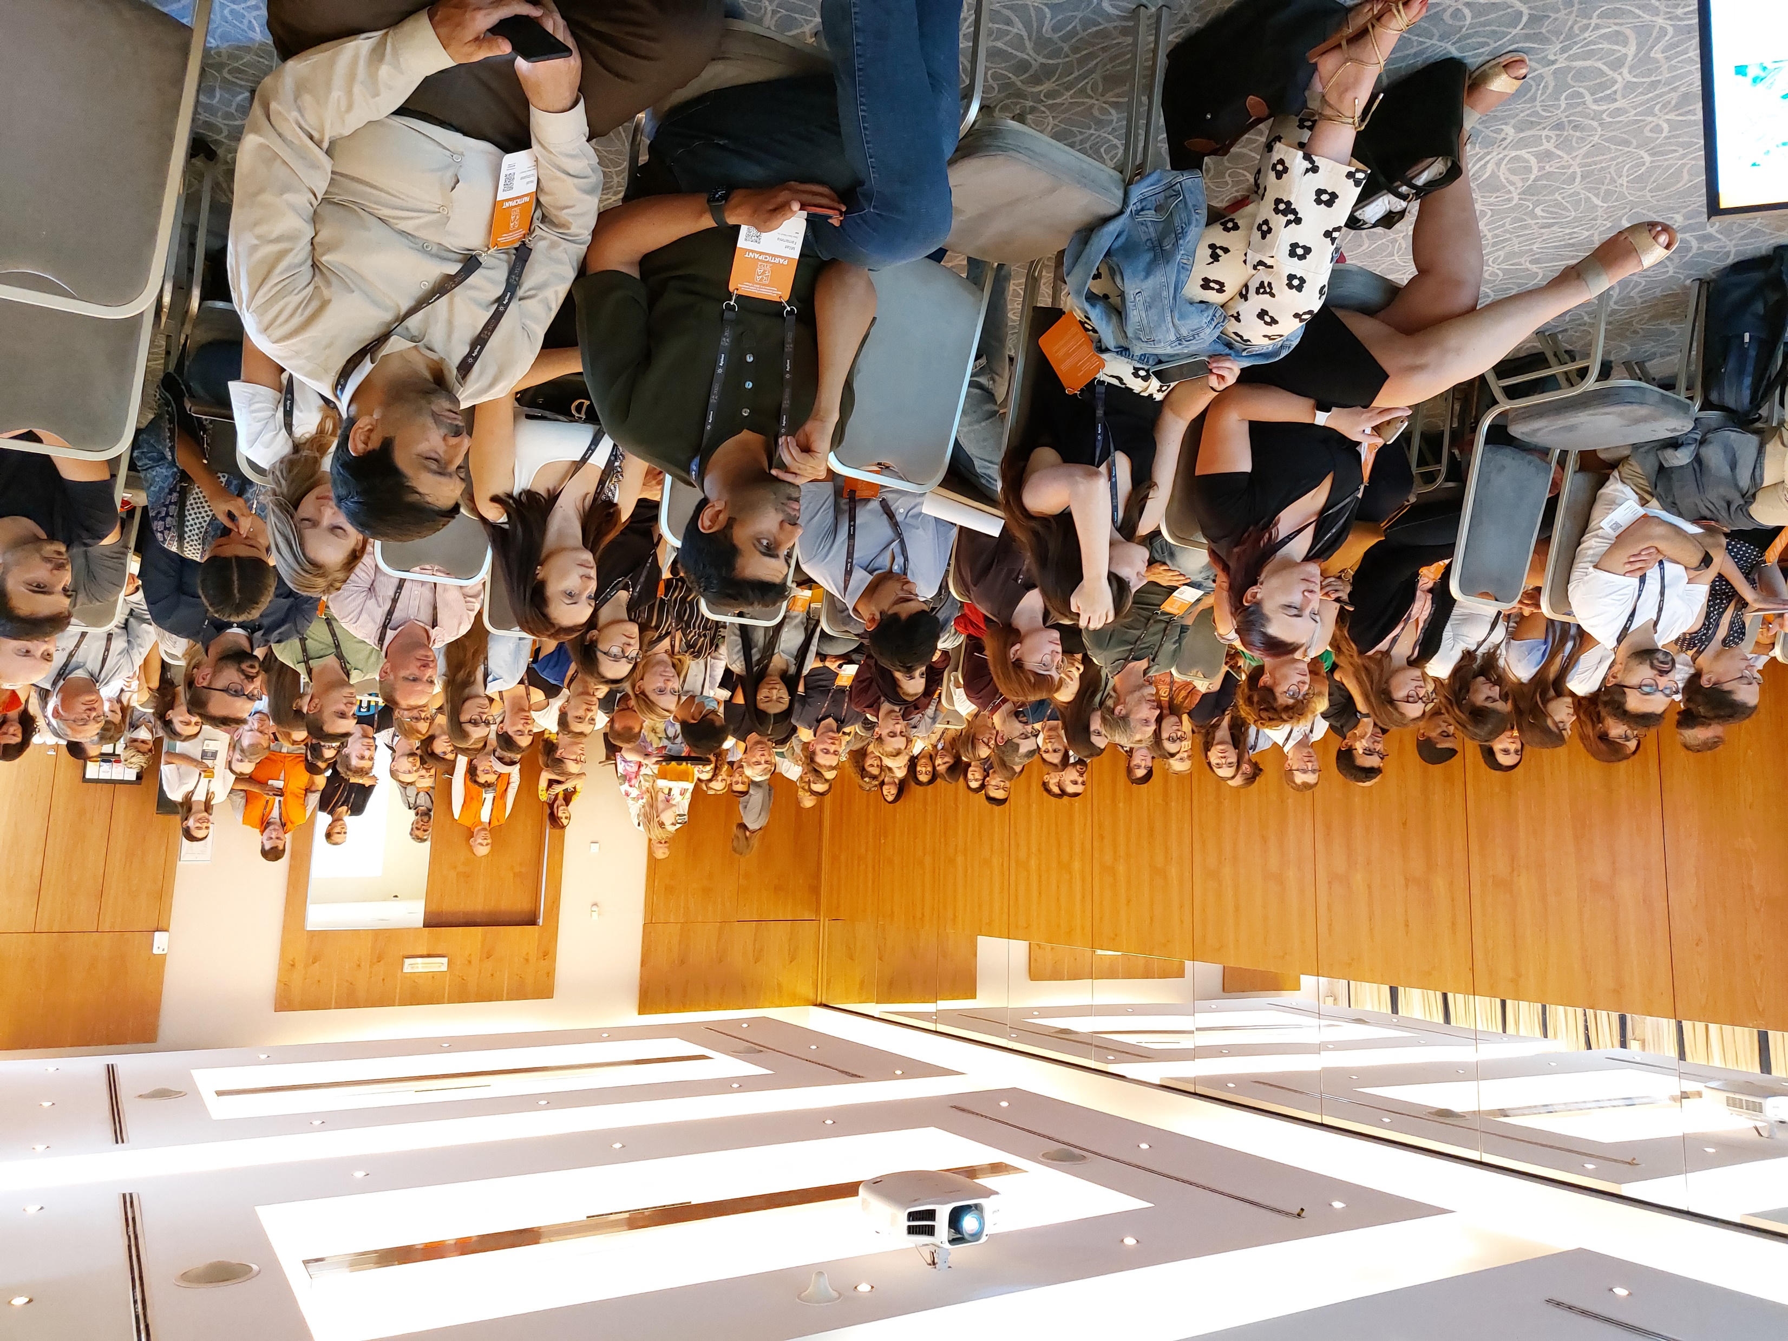
Beer!!!

Slide 26

Final Insights
EURL attests that also rapid methods can function properly
Metabolomics: data handling is as important as the analytical method; sample size makes the difference
HS-GC-IMS seems to become a new very promising technique in flavour analysis, with many apllications
DNA metabarcoding is exploited to new matrices
Combining paper microfluidics (for analyte pre-concentration) to mid-IR spectroscopic detection (potentially at the point-of-need) can revolutionize the current status of cost-effective approaches
Challenges also within the mycotoxin and plant toxin area in relation to new regulation on performance criteria
Very limited info on risks and hazards of novel food and feed for circular food production
Don’t trust the healing position: call to action to ensure the safety of food supplements
Great steps forward in microplastics identification, for instance polymer-ID by MS using the ASAP probe
Innovative smart sampling for example by coated blades facilitating in-field sampling/sample prep/transport
Sample prep is going green: novel strategies improving sustainability & ensuring high quality analytical parameters
Artificial Intelligence in food and nutrition can help to complete food composition databases

Slide 27
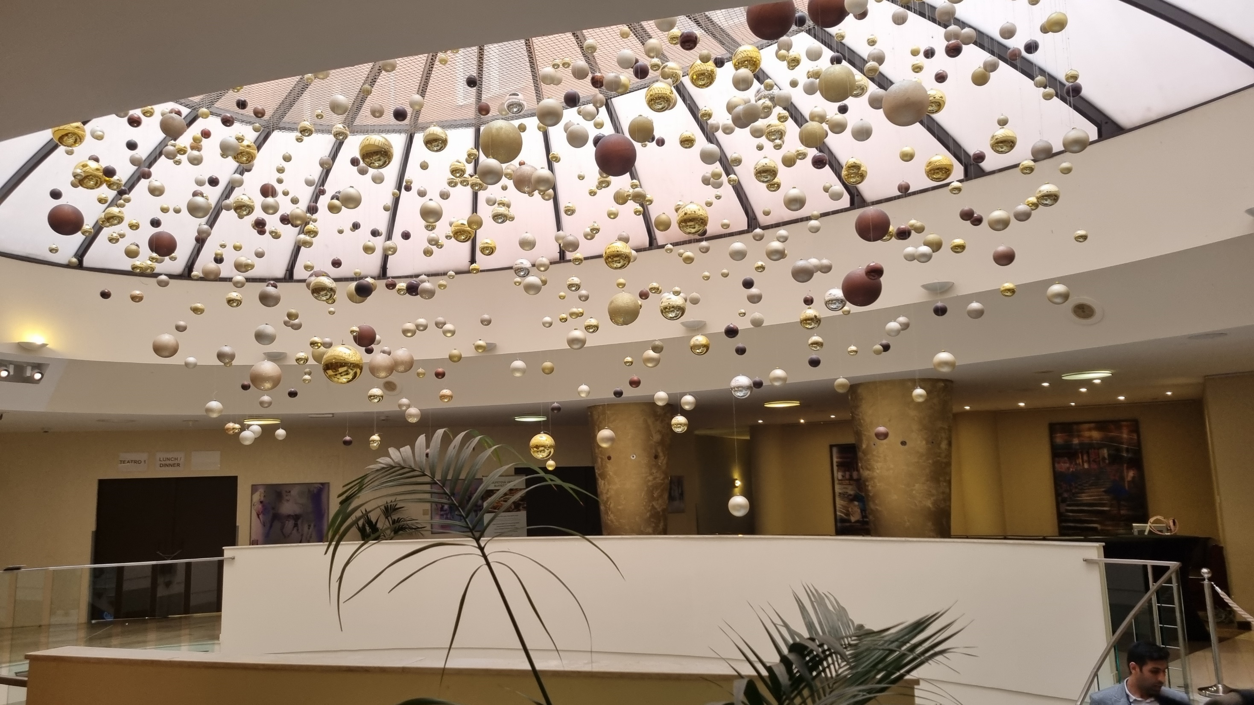
…and finally…after three years…
the Magic of RAFA is here again…

Slide 28

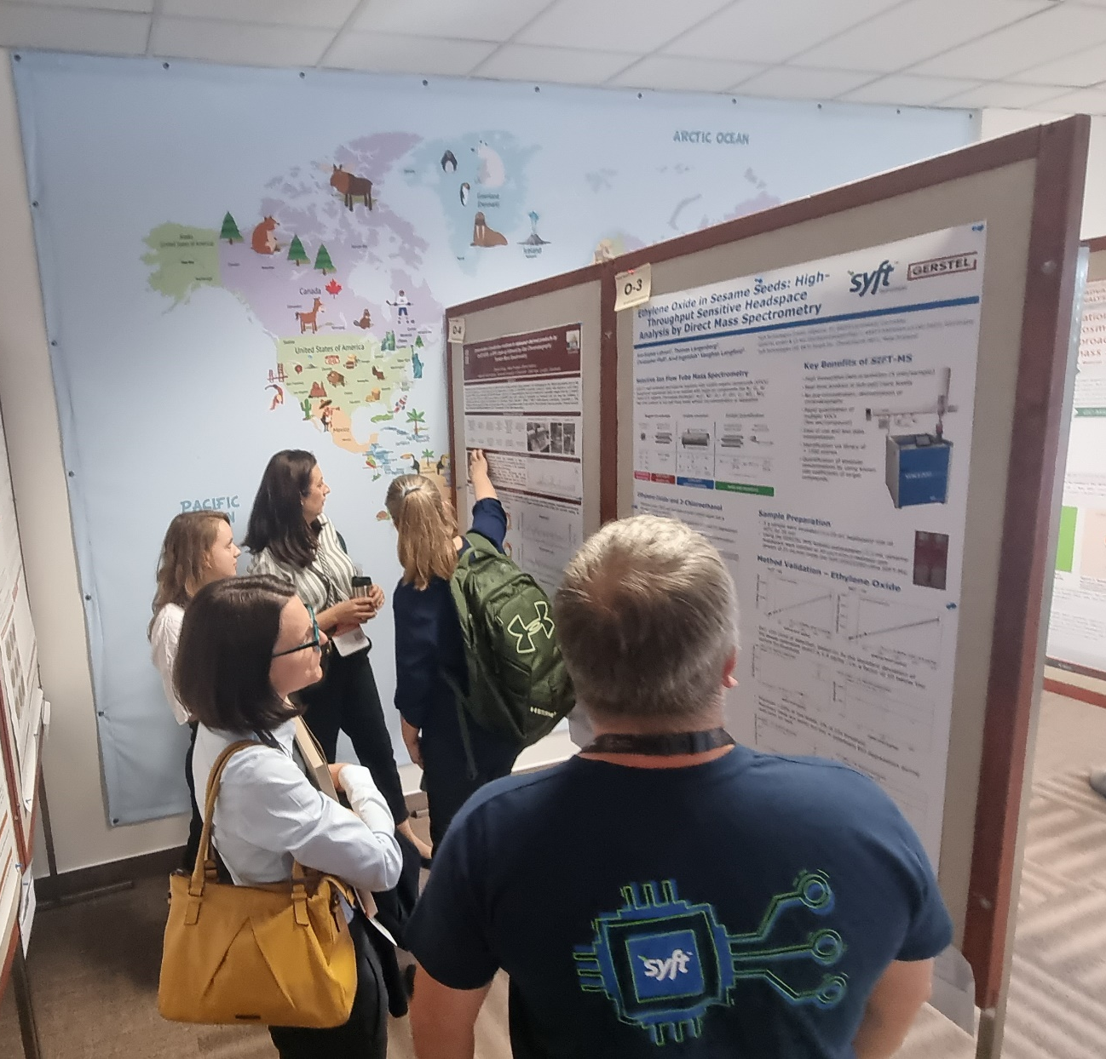
…because this is RAFA…

Slide 29
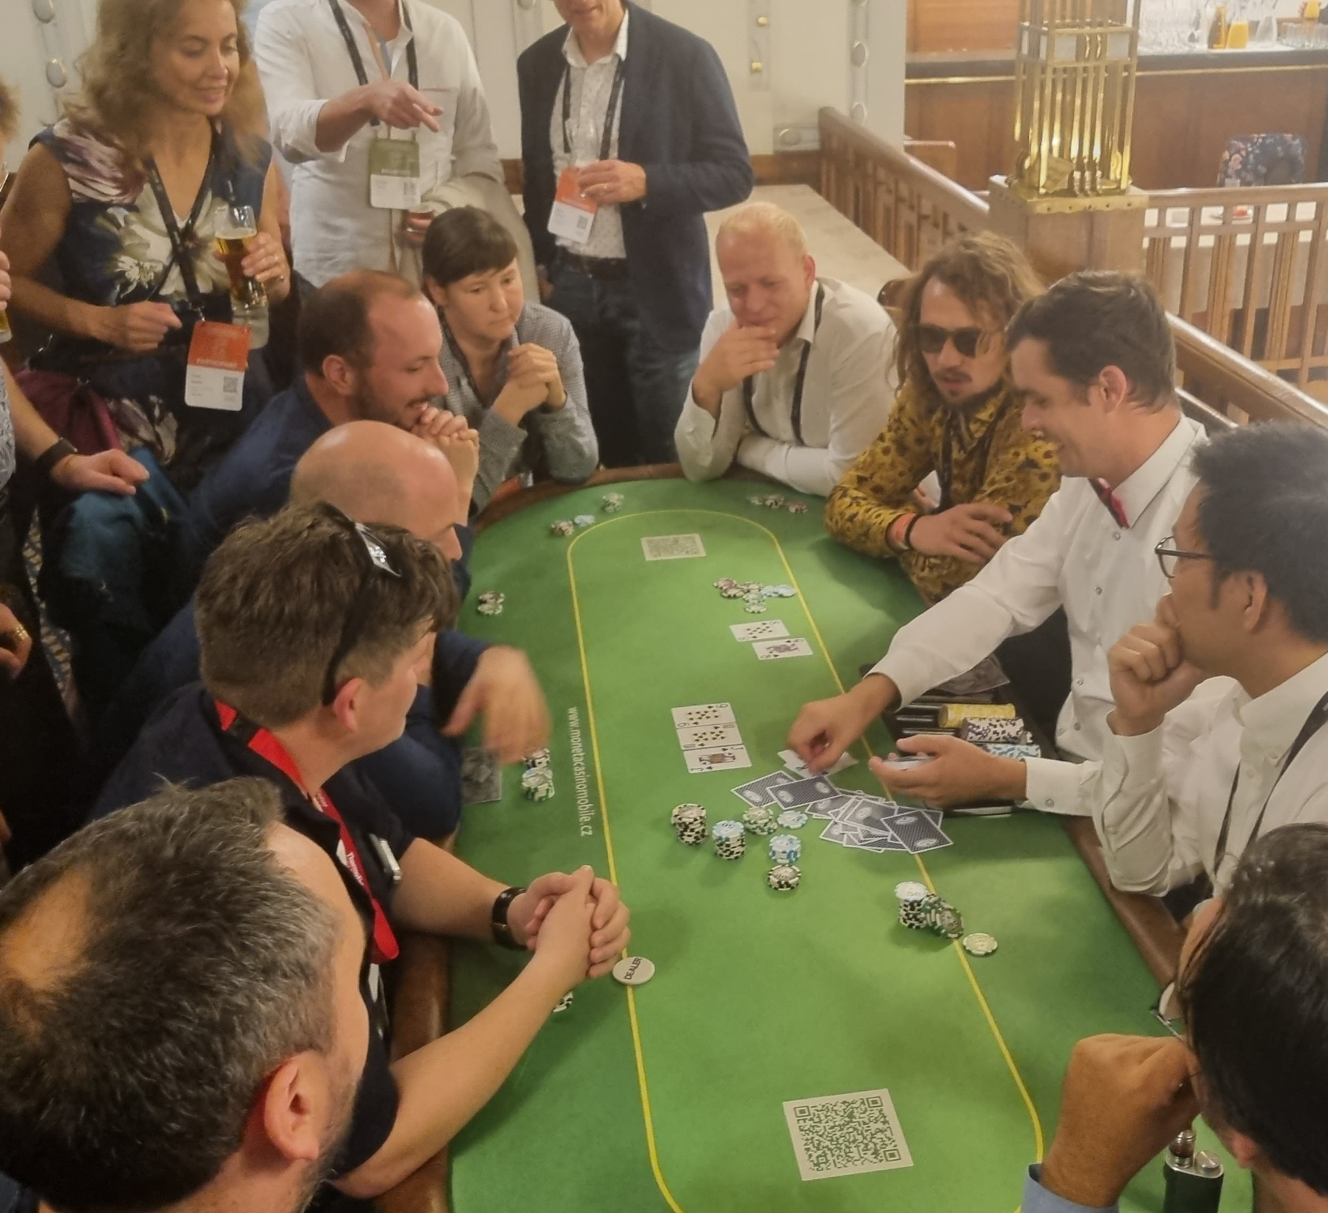
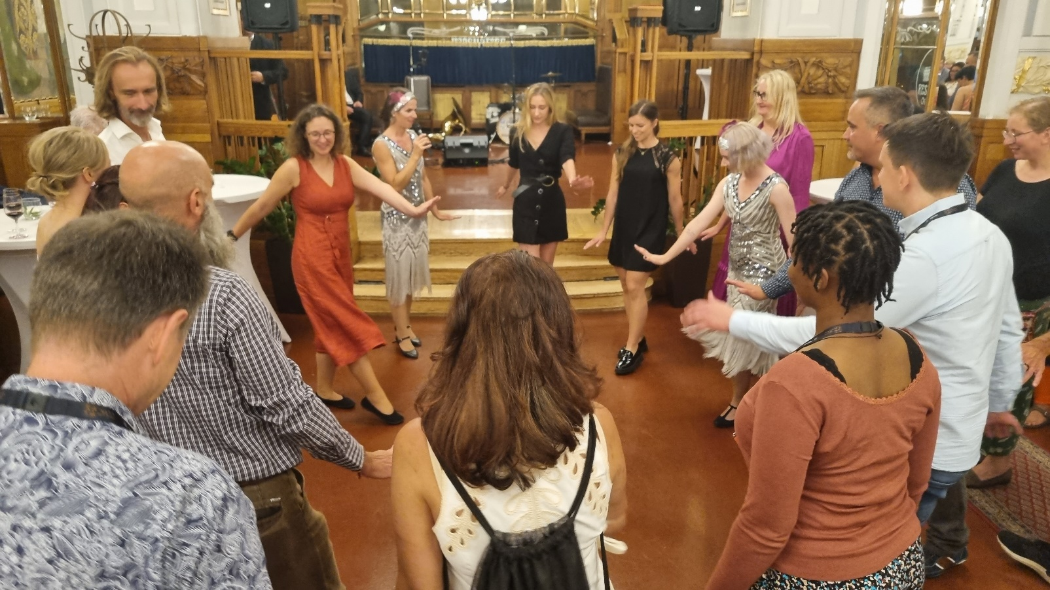
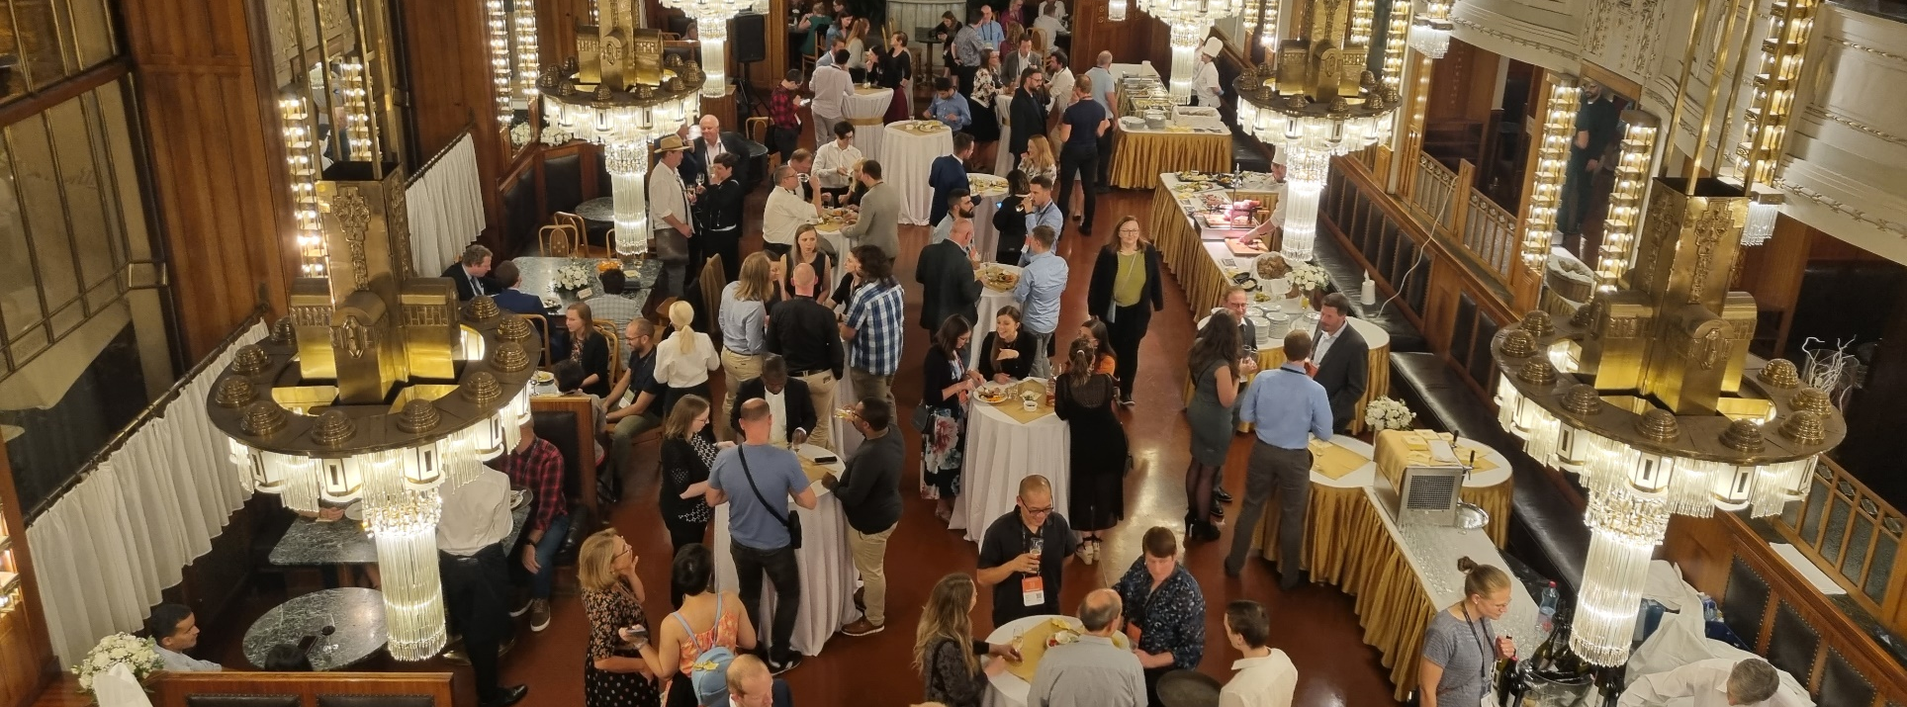
…and this is RAFA…

Slide 30


…and this is RAFA…

Slide 31


…and this
Is also RAFA…

Slide 32



Slide 33

Renewed Awareness
Friendship Affirmation
that…

Slide 34



